Slide 1
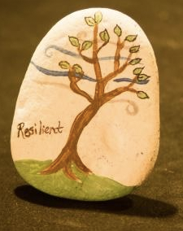
healthy body & creative flow
Sheena Brown Ph.D, MPH
sheenab@email.arizona.edu
Deanna Fitzgerald BA, MFA, RYT-200
deannaf@email.arizona.edu

Slide 2
https://www.youtube.com/watch?v=noCWtagaDJQ
As you are watching, pay attention to:
thoughts and emotions
any physical sensations
Notes:
The point here is – as well as our stress response being engaged during stressful events we directly experience, the effects of perceived stress also elicit the stress response

Slide 3
“So, how is stress like ice cream?
Well, a little now and then is ok,
a triple serving may only make you temporarily sick,
but "all you can eat" might kill you!”
Robert Sapolsky
Notes:
Our bodies are well developed physiologically to cope with acute stress – but experiencing stress, long term, day in and day out, that’s when it becomes harmful
Why Zebra’s Don’t get Ulcers by Robert Sapolsky

Slide 4
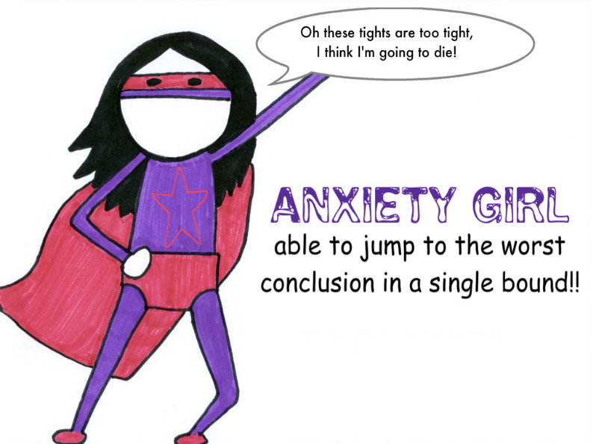
Chronic Stress = Chronic Disease
RESS ANXIETY DEPRESSION STRESS ANXIETY DEPRESSION
Notes:
Physiologically, our bodies can’t tell the difference between ‘survival’ stress and ‘tight tights’
Living in a constantly stressed state, we are primed to react
If we can’t change the circumstances, we can change how we respond to those circumstances

Slide 5
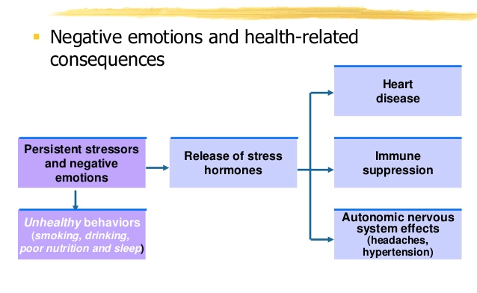
Stress-related emotions &
health-related consequences
Perceived stressors
Asthma. ...
Obesity. ...
Diabetes. ...
Depression and anxiety. ...
Gastrointestinal problems. ...
exercise
Notes:
Negative Emotions play a role in inducing the stress response

Slide 6
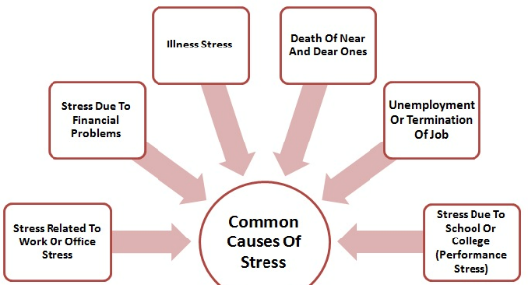
Chronic Stress
Notes:
If we agree that our emotions play a significant role in inducing / maintaining stress levels
Can we reframe this?

Slide 7
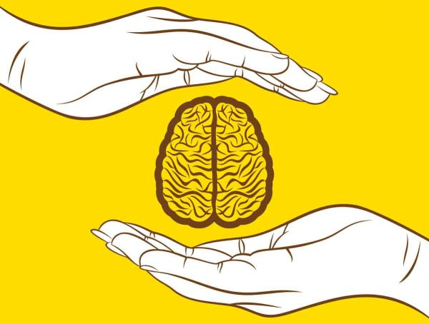
Enhanced Emotional Wellbeing = Enhanced Health
“Exercising our minds should be approached much in the same way we exercise our bodies.”
R. Davidson
Notes:
Just as when we learn anything new e.g. playing the piano, it takes practice to become competent. You don’t take piano lessons for a week and expect to be playing Rachmaninov
What is evidence for this?

Slide 8
Richard J. Davidson, Ph.D.
William James & Vilas Research Professor of Psychology & Psychiatry
Director of the Waisman Laboratory for Brain Imaging & Behavior
Founder of the Center for Healthy Minds at the Waisman Center, University of Wisconsin-Madison
Research focus - neural bases of emotion and emotional style and methods to promote human flourishing including meditation and related contemplative practices.
Study populations: persons from birth though old age; individuals with emotion disorders e.g. mood and anxiety disorders and autism; expert meditation practitioners with tens of thousands of hours of experience.
Research methods: MRI, positron emission tomography, electroencephalography and modern genetic and epigenetic methods
http://centerhealthyminds.org
Notes:
there is a growing body of literature, from well respected researchers, that engaging in contemplative practices can enhance our wellbeing, and such changes can be quantitatively measured in the brain

Slide 9
MISSION
Cultivate well-being and relieve suffering through a scientific understanding of the mind
What constitutes a healthy mind?
“To begin to answer this, we’ve investigated the science of emotions, contemplative practices and qualities of mind we suspect affect well-being, including attention, resilience, equanimity, savoring positive emotions, kindness, compassion, gratitude and empathy”

Slide 10
Four key constituents of well-being
Sustaining Positive Emotion
a sense of purpose, meaning, and engagement with life - is protective against psychopathology and predicts physical health, including lower levels of cortisol
2. Rebounding from Negative Emotion
Those with greater self-reported purpose in life show increased resilience and greater well-being
3. Mindfulness and Mind-Wandering
When people are really focused on what they're doing, and their minds are not wandering, they actually feel better about themselves
4. Caring for Others
Empathy, compassion and gratitude

Slide 11
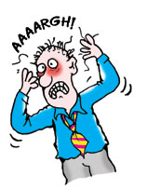
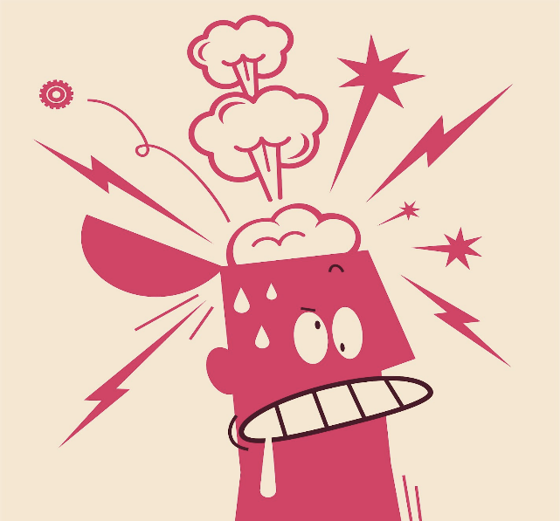
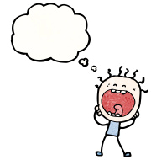
wellbeing is a skill that can be learned
Waaaaaa

Slide 13
1. Sustaining Positive Emotion
Eudaimonic well-being - a sense of purpose, meaning, and engagement with life - is protective against psychopathology and predicts physical health, including lower levels of cortisol
Suggests that sustained engagement of reward circuitry in response to positive events underlies well-being and adaptive regulation of the hypothalamic-pituitary-adrenal axis
Notes:
Well-being is a complex construct that concerns optimal experience and functioning. Current research on well-being has been derived from two general perspectives: the hedonic approach, which focuses on happiness and defines well-being in terms of pleasure attainment and pain avoidance; and the eudaimonic approach, which focuses on meaning and self-realization and defines well-being in terms of the degree to which a person is fully functioning.
Whether it's savoring that last bite of dessert or carrying the enjoyment of an activity with friends or family, or seeing the seeds of kindness and compassion in each person, prolonging positive emotion and having a positive outlook have been shown to improve psychological well-being. In studies examining the brain's response to positive images (for instance, a mother embracing her infant), we found that people with more sustained levels of activity in the ventral striatum, an area linked to positive emotion and reward, report higher levels of psychological well-being and display lower levels of cortisol (a stress hormone that's good in moderation, but problematic in excess). In another study, we discovered that prolonged marital stress was related to a decreased ability to sustain positive emotion, which we think can create a susceptibility to depression.

Slide 14
2. Rebounding from Negative Emotion
Enhanced resilience can result in a person experiencing less negative emotion overall and may have protective properties against mental health disorders
Those with greater self-reported purpose in life show increased resilience and greater well-being
Cultivating purpose, may also promote well-being
Promising evidence suggests certain types of mental training help cultivate resilience and facilitates more rapid recovery from negative events
Notes:
Science in this area suggests resilience, or how quickly a person recovers from adversity, can result in a person experiencing less negative emotion overall and may even have protective properties against mental health disorders.
But for some with depression who "can't shake that feeling" after a negative experience, areas in their brain related to strong emotion such as the amygdala remain active longer after the negative event has ceased. The same has been found in individuals with higher levels of neuroticism.
When it comes to building skills in this area, we found people with greater self-reported purpose in life (based on a questionnaire) show increased resilience and greater well-being. If we can find ways to cultivate purpose, we may also promote well-being. There's also promising evidence suggesting certain types of mental training to help cultivate the skill of resilience and facilitate more rapid recovery from negative events.

Slide 15
3. Mindfulness and Mind-Wandering
Mindfulness: the practice of bringing one's attention to the internal and external experiences occurring in the present moment, without judgment, and with lessons learned from past experiences
When people are really focused on what they're doing, and their minds are not wandering, they actually feel better about themselves
Being in the present moment can lessen the tendency to want and desire things we don't have
Acceptance of self & others

Slide 16
4. Caring for Others
Empathy, compassion and gratitude comprise another component of well-being
Evidence suggests that engaging in acts of generosity is an effective strategy to increase well-being
The ‘double positive whammy effect’, by being generous to others you benefit both them and yourself
Compassion training – primes a person's ability to empathize with others and leads to pro-social behavior aimed at decreasing others' suffering
Notes:
Pro-social qualities such as empathy, compassion and gratitude comprise another component of well-being. There's substantial evidence to suggest that engaging in acts of generosity is an effective strategy to increase well-being. We call it a double positive whammy because, by being generous to others, you benefit them and yourself. Studies, including one from our lab, show that compassion training – in which one generates positive wishes for another being – primes a person's ability to empathize with others and leads to pro-social behavior aimed at decreasing others' suffering.

