Slide 1
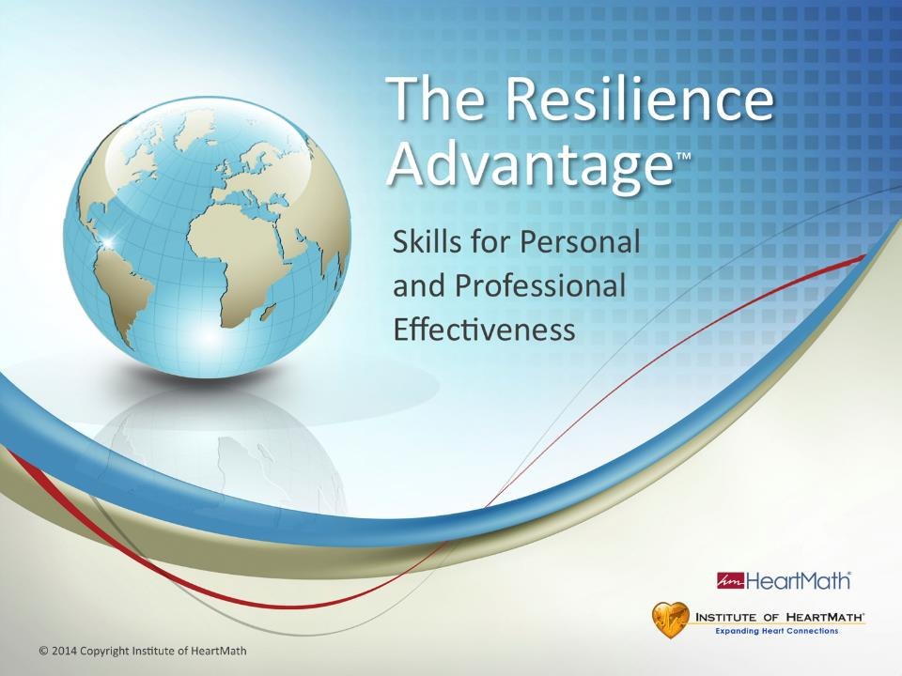
Notes:
Time: 3 minutes
Objective: Introduce yourself, welcome everyone to the training and build rapport with participants.
Key Points:
(Welcome and build rapport with participants.)
(Introduce yourself. Tell an appropriate story relating to the benefits you’ve gained using the HeartMath tools.)
(Discuss logistics: breaks, restroom locations, guidebooks, etc.)
(Announce modules or give overview of topics you plan to cover.)
Optional opening comments:
Today you will learn simple, resilience-building techniques you can use throughout the day.
Resilience gives you the benefits of better sleep, improved teamwork and morale, the ability to deal with difficult clients and increased ability to focus, process information, solve problems and enhance creativity.
As with most things that are worthwhile, it does take effort to build your resilience. The skills you will learn today are very practical and can be used on the go, no matter what you are doing or where you are.
(Discuss break times, how the workshop will unfold, such as in individual and small group exercises, time for personal reflection, program evaluation if you plan to ask them to do one and other relevant logistics.)
Transition: There is a wide range of organizations using the same resilience skills you will learn today.

Slide 2
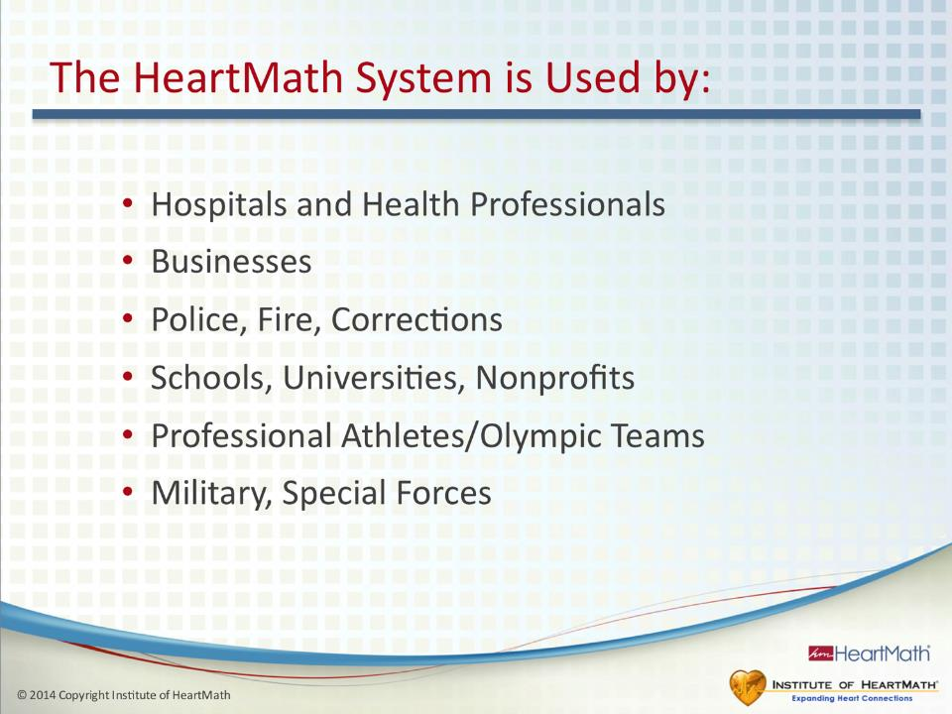
Notes:
Time: 1 minute
Objective: Build program credibility.
Key Points:
Many people around the world and in a variety of organizations use the HeartMath System.
The resilience-building skills are taught in various training programs tailored to specific types of audiences.
Additional Key Points:
• The HeartMath System is used by: Businesses, nonprofits, hospitals and health professionals that want to improve the culture of their workplace environments and reduce escalating health-care costs.
• Police, fire and corrections organizations that want to improve their personnel’s ability to respond effectively and appropriately without the depleting effects of prolonged stress.
• Schools, universities and youth agencies that want to improve student behavior and academic performance while lowering stress.
• Olympic teams and elite athletes who want to gain an advantage in their performances.
Military personnel seeking to build stress resilience and reduce post-traumatic stress disorder.
Transition: Research across a wide range of topics and applications validates the HeartMath System.

Slide 3
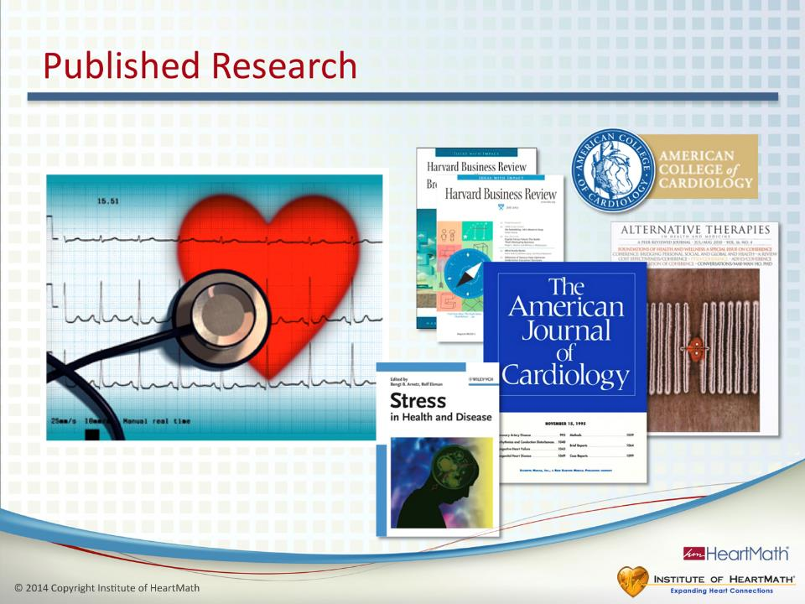
Notes:
Time: 1 minute
Objective: Build further program credibility.
Key Points:
•The HeartMath System is an evidence-based methodology. The HeartMath Research Center, independent researchers and universities have published numerous studies that validate the HeartMath System.
•These studies have been published in numerous peer-reviewed journals.
Resilience Advantage Slide Notes © Copyright 2014 Institute of HeartMath
Additional Key Point:
•Among many other journals, HeartMath’s research has been published in the American Journal of Cardiology, Global Advances in Health and Medicine, Stress Medicine and the Journal of the American College of Cardiology. All material presented in this program is backed by research. A bibliography referencing the material presented in the workshop is located in the back of the guidebook.
Transition: Let’s look at the objectives for today’s program.

Slide 4
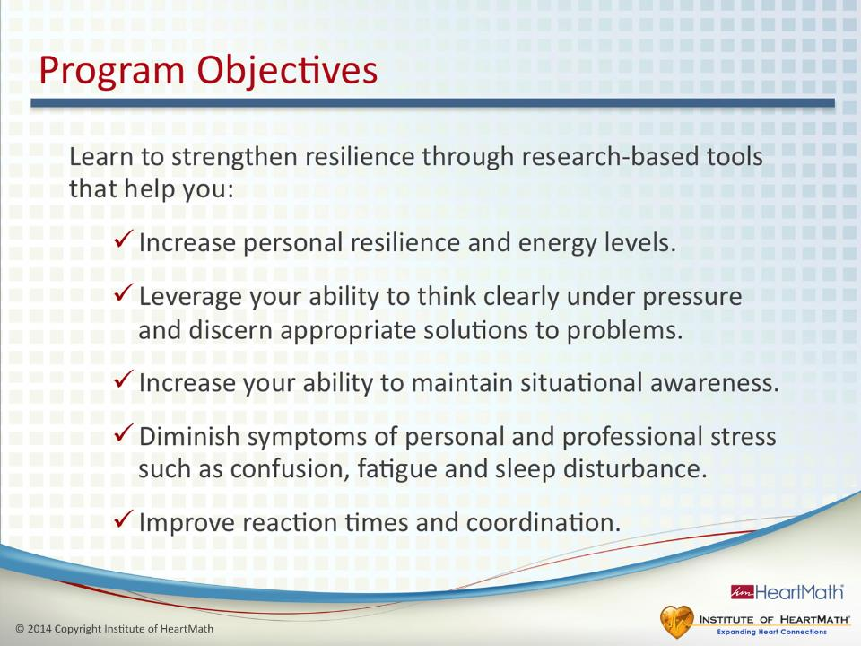
Notes:
Time: 1 minute
Objective: Provide program objectives.
Key Points:
•Increase your personal resilience and energy levels.
•Leverage your ability to think clearly under pressure and discern appropriate solutions to problems.
•Increase your ability to maintain situational awareness.
•Diminish symptoms of personal and work-related stress such as overwhelm, frustration, fatigue and sleep disturbance.
•Improve reaction times and coordination.
Transition: What is resilience all about?

Slide 5
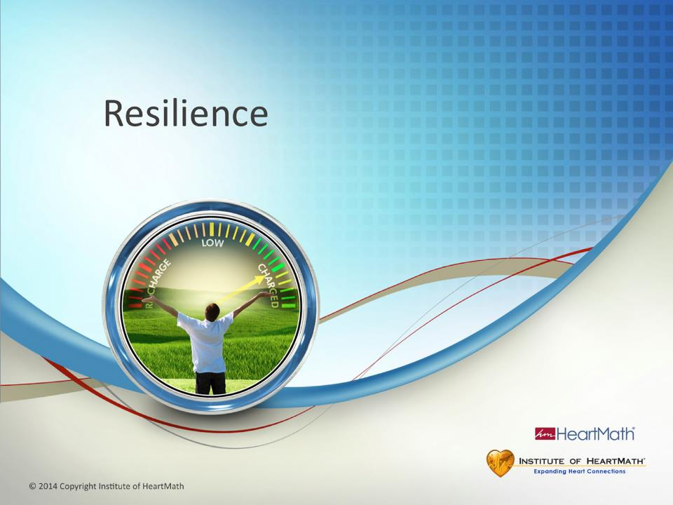
Notes:
Resilience Introduction
Time: 1 minute
Objective: Engage the audience in talking about what resilience means to them.
Key Points:
Ask: What does “resilience” mean to you?
Additional Key Points:
(Optional) Ask: When you are resilient, what do you notice about yourself?
Resilience is commonly thought of as the ability to bounce back after a challenging situation. It’s important to be able to bounce back, but there is much more to resilience than bouncing back.
Transition: Let’s look more closely at resilience, why it’s important and its practical benefits.

Slide 6
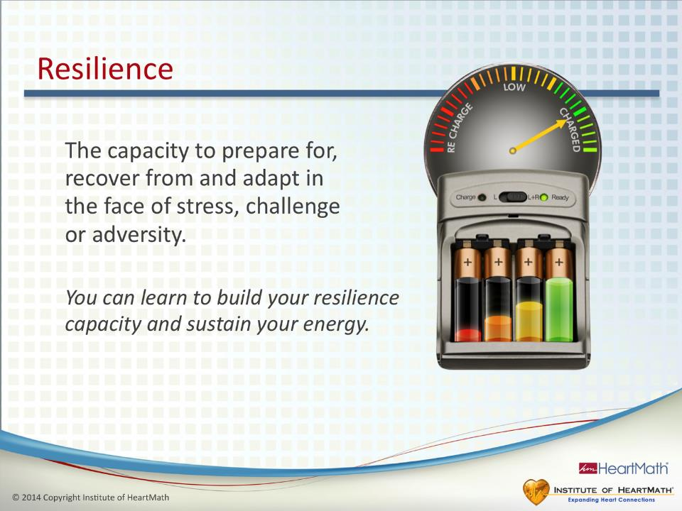
Notes:
Time: 3-5 minutes
Objective: Introduce participants to the concept of resilience, why it’s important and its benefits.
Key Points:
•Our understanding of resilience has been evolving. The HeartMath definition of resilience captures a newer and broader understanding of resilience. (See slide.) Resilience is the capacity to prepare for, recover from and adapt in the face of stress, challenge or adversity.
•Capacity is a key term that is fundamental to understanding resilience. Capacity is how much of something you can have.
•You can increase your capacity and accumulate or store resilience.
•Greater capacity means you have more to draw from when you need it.
•You can think of your resilience as the amount of energy you have stored in an inner battery. It’s the amount of energy you have available.
•Ask/Say: Think of an event or situation that irritates or frustrates you. When your energy level is low, how do you respond in that situation? Are you more easily frustrated? Does it get under your skin more easily? When your inner battery is charged, how do you respond? Are you more flexible and do you roll with the punches? Can you think more clearly? (Pause.) The situation is the same. The difference in the way you respond to things often depends on the amount of energy you have available.
•Resilience capacity varies from day to day.
•Having more resilience/energy in your inner battery helps you to be better prepared for and often avoid many of the situations and challenges from which you need to bounce back or recover.
•The greater your capacity and resilience, the greater your ability to maintain your composure and stay in charge of your reactions and perceive things more clearly.
•Building and sustaining resilience means becoming more intelligent about how you use your energy and replenish your energy reserves.
•Greater resilience helps to prevent stress buildup.
•In other words, the more intelligently you manage your energy expenditures and recharge your inner battery, the more energy you have and the more resilient you are. You then have greater ability to self-regulate and be in charge of your emotions in the moment.
Transition: Let’s expand the resilience concept further.

Slide 7
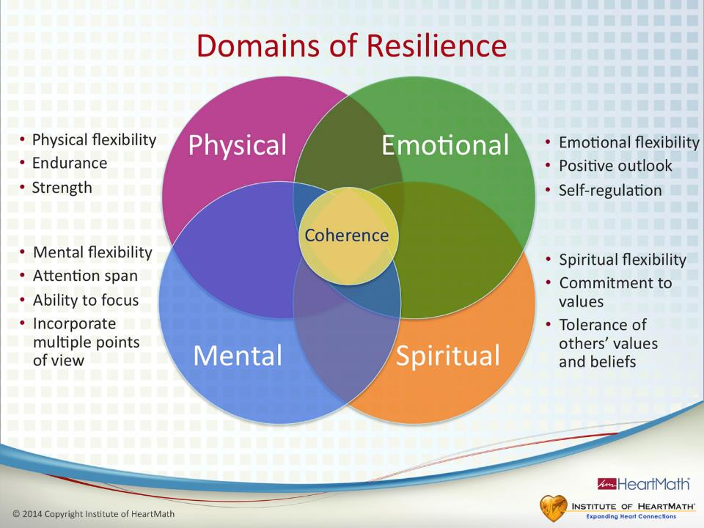
Notes:
Time: 3-5 minutes
Objective: Inform participants about the four domains of resilience, emphasizing that the emotional domain is the key to building resilience and increasing capacity.
Key Points: •There are four primary domains of resilience: physical, mental, emotional and spiritual.
•We have resilience in each domain.
•Some people are naturally more resilient in one domain than another.
•Each domain affects the others. An example of this interrelation would be feeling overwhelmed and frustrated (emotional domain) because you have too much to do and then having difficulty thinking clearly (mental domain). This could also cause tense muscles (physical domain) or less tolerance of another’s beliefs (spiritual domain.)
•As you can see on the slide, resilience is reflected in each domain. For example, in the physical domain, resilience is reflected in our endurance, strength and physical flexibility.
•Building capacity in any domain means you must stretch beyond your norm and then stabilize at that new level. Doing this increases your baseline capacity.
•It is in the emotional domain that we tend to waste a lot of energy unnecessarily.
•Ask: How do you feel an hour after becoming very angry?
•Ask: If someone else triggered your anger, whose energy is being drained?
•Plugging energy leaks in the emotional domain saves a lot of energy and builds your resilience capacity. This affects all the domains.
•Building capacity is key to enhancing one’s ability to self-regulate. Let’s use an example in the physical domain to look more closely at what we mean by building capacity.
•Ask: How can you build your physical capacity? Push-ups, running, lifting weights? You increase your capacity by “taking on a challenge” such as increasing the amount of weight you lift or walking farther. Gradually, that increased weight or distance becomes your new norm. You’ve increased your capacity.
•Ask: What would be some reasons you would want to build your physical capacity? Greater capacity, in this case physical strength or endurance, means you have more to
draw on when you need it.
•Building capacity works the same way in each domain. In this program you’re learning to build greater capacity in the mental and emotional domains. Let’s use the example of a traffic jam, which all of us probably have experienced, to see what “taking on a challenge” and building capacity looks like in the emotional domain.
•Ask: What are common responses people have in traffic jams? Impatience? Anger? Frustration? Does feeling impatient or frustrated move the traffic any faster? Whose energy is being drained? Taking on that challenge and choosing not to let the traffic jam bother you builds your capacity to be in charge of your emotions and how you respond. You are building your emotional muscle so you have more capacity to self-regulate not only in traffic jams, but in other situations as well.
Transition: Here’s a good illustration of the powerful effect emotions have on our physiology.

Slide 8
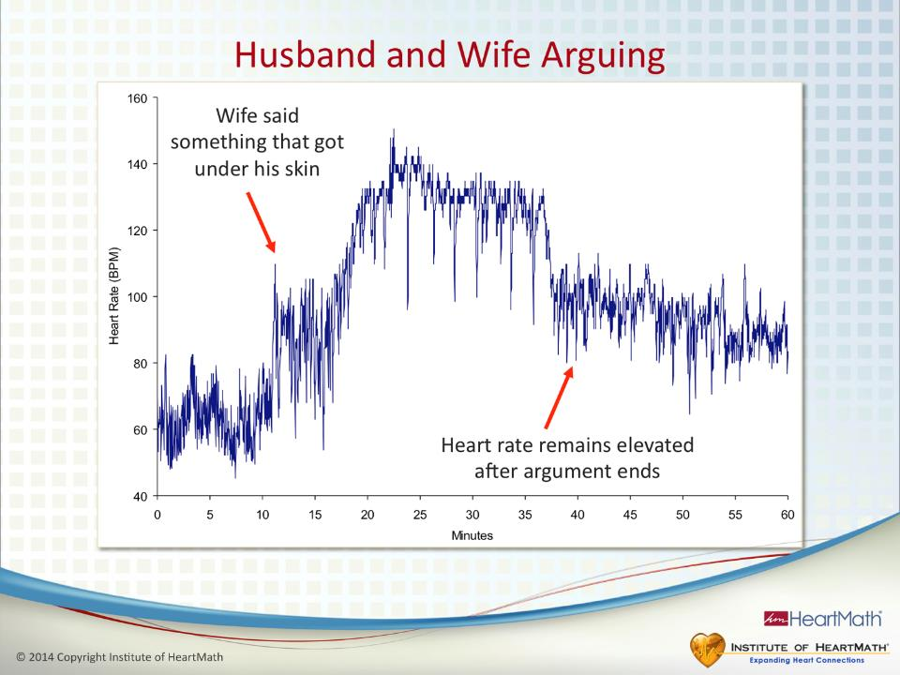
Notes:
Time: 2 minutes
Objective: Illustrate the idea that emotions are primary drivers of our physiology.
Key Points:
A man was wearing a 24-hour Holter monitor, which is used to measure heart rhythms.
He and his wife were arguing in their car. The man was sitting on the passenger side wearing his seatbelt. When they began arguing, his heart rate shot up to over 140 BPM and remained elevated at that rate for about 15 minutes.
After they made up, his heart rate remained elevated for another hour. (Point to second red arrow.)
Ask: How much energy did he burn up from being angry or frustrated?
The result was a rapid drain of his inner battery. This is a good way of illustrating that emotions are primary drivers of physiology.
Ask: How much emotional energy is unnecessarily spent in the workplace because of drama, relationship and communication issues?
Transition: Our emotions directly affect our resilience.

Slide 9
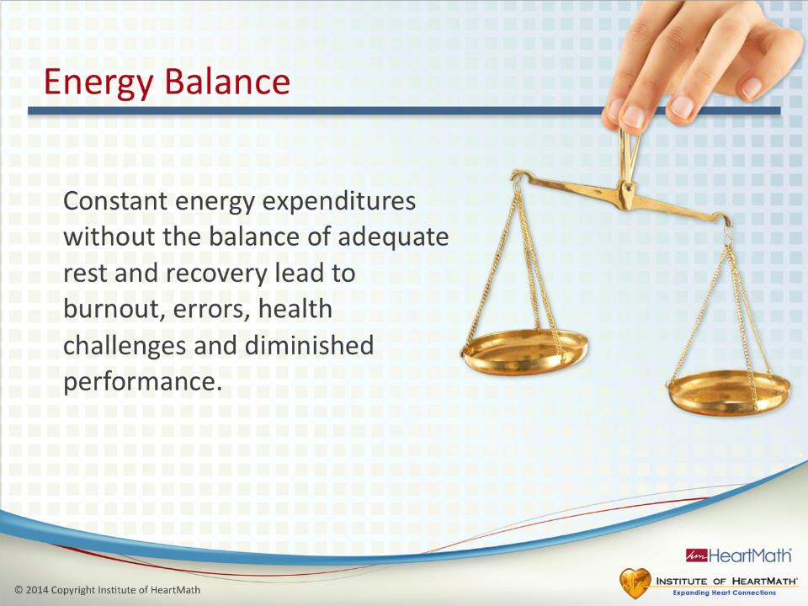
Notes:
Time: 1-2 minutes
Objective: Explain the concept: We tend to expend more energy than we renew.
Key Points:
People tend to expend more energy than they recover.
It’s the constant energy expenditure without adequate renewal that leads to diminished resilience.
Ask: What do you notice when your personal energy is low? Do you tend to make more mistakes? Do little things tend to get under your skin more easily?
Sleep is one of the primary ways we renew energy.
Additional Key Points:
One way to understand energy expenditures and renewal is to consider what happens to your cell phone when you use it a lot during the day and don’t recharge it at night. The battery drains. It works the same way when you don’t keep your inner battery charged. The energy in your inner battery drains and your resilience drops. Eventually, decreased resilience leads to burnout, mistakes, reduced performance and diminished health.
Carryover effects from stressful feelings such as frustration or annoyance deplete your system and are major factors in disrupting the quality of your sleep and your ability to renew and recharge your inner battery. When you don’t get enough sleep or you sleep poorly, your inner battery can’t fully recharge. That means starting the next day with less resilience.
Transition: Next, let’s look at how depletion can affect our health, behavior and performance over time.

Slide 10
Stress, Resilience and Performance
Embraces challenge and improves performance
Period of
maximum efficiency
Hyper-reactive
stage
Emotional exhaustion
stage
Breakdown
Time (Days)
Notes:
Time: 3 minutes
Objective: Explain the concept that sustained energy output associated with challenges or stress affects our health, behavior and performance.
Resilience Advantage Slide Notes © Copyright 2014 Institute of HeartMath
Key Points:
•Ask: Are you familiar with the idea that stress can improve performance? People often talk about “good stress” and how they need stress to get the job done. That can be true, but only to a point.
•A better term than stress in this context is challenge.
•What people often mean is they need a challenge to motivate them to get the job done.
•(CLICK to add the next text block.)
•When faced with a challenge such as a project, sporting event or relationship issue, we can increase performance by embracing the challenge and having a positive attitude about it, meaning that it’s something we enjoy doing.
•(CLICK to add the next text block.)
•(Point to the top of the red line under “Period of Maximum Efficiency.”) The increase in performance is followed by a period of maximum efficiency.
•Ask: If a challenge is not embraced with a positive attitude, what do you think happens to performance?
•(Point to the red line.) If the level of stress or challenge remains high without adequate tools for maintaining resilience, your energy could become drained and your performance could begin declining. Basically, the charge in your inner battery begins dropping. (CLICK to add the next text block.) This is called the hyper-reactive stage. This is the point at which we are more reactive and anxious. People experience more memory problems in this stage and mistakes start occurring. This is when the small stuff starts to get to us. It’s also when it becomes more difficult to self-manage reactions, emotions and attitudes, all of which can trigger a downward spiral and further energy drain.
•(CLICK to add the next text block.)
•The next stage is called the emotional exhaustion stage. This is when your inner battery becomes even more depleted, resulting in more serious problems.
•(CLICK to add the next text block.)
•The goal is to reach the blue line, where you can sustain your resilience and performance over time.
•Using the techniques in this program and being more intelligent about how you expend and renew energy can help you build and sustain resilience.
•Ask: Can you relate to any of this?
Transition: Ask: Anyone up for watching a movie?

Slide 11

Notes:
Time: 15 seconds
Objective: Prepare participants to watch the movie.
Key Points:
Notice how you feel as you watch the movie.
(Click to the next slide and play the movie.)
Ask: Does anyone remember the caption at the end of the movie? (Wait for response.) You see the world through how you feel.
Transition: Ask yourself what was your soundtrack when you were watching the movie?

Slide 12






© 2014 Copyright Institute of HeartMath
© 2014 Copyright Institute of HeartMath
Notes:
Play the movie

Slide 13
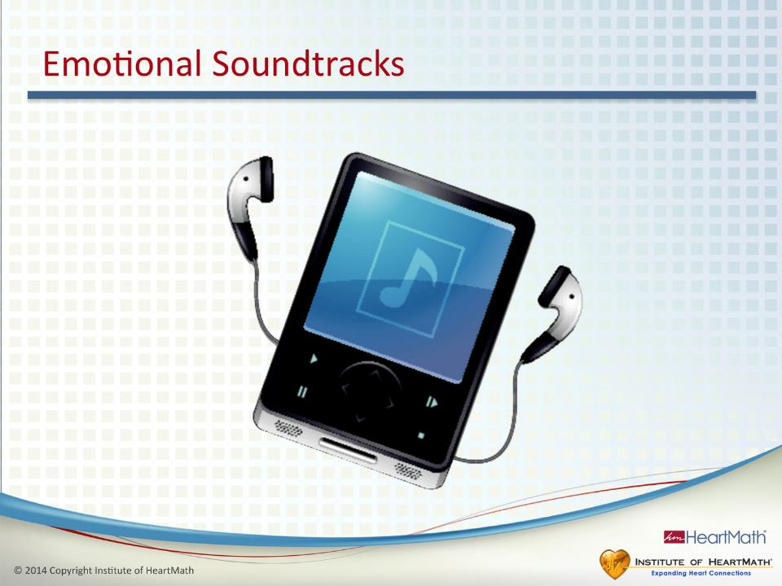
Notes:
Time: 3 minutes
Objective: Introduce the concept that emotions are like background music and influence the quality of our life experience, perceptions, decisions and relationships.
Key Points:
•Ask: What did you experience during the first taxi ride? (Examples of possible responses are chaos, tension, unease and overwhelm.)
•Ask: What did you experience during the second taxi ride? (Examples of possible responses include calm, harmonious, a slower pace and hopeful.)
•Ask: What was the difference between the two movies? Did you notice that the only difference between the two movies was the background soundtrack?
•The perception of what we experienced changed based on how we felt about the music.
•Just like the film’s background music affected how we felt, emotions influence our perception and the quality of our day.
•Emotions run in the background all the time, whether or not we are aware of them. Ask yourself, what are the inner soundtracks you run in the background?
•These two movies illustrate that our emotions influence our perceptions, decisions and relationships – nearly everything that happens in our daily lives.
Transition: Emotions not only affect the quality of our day, but can have other significant effects too.

Slide 14
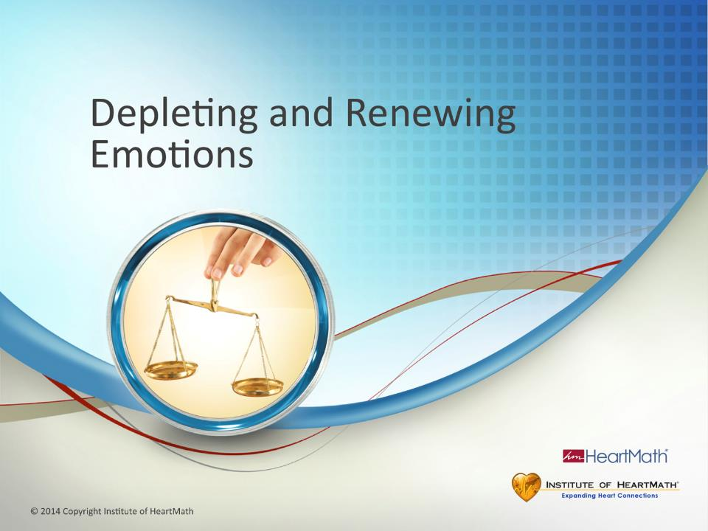
Notes:
Time: 1 minute
Objective: Inform participants about the role emotions have in influencing our energy, resilience and what motivates us.
Key Points:
Our emotions have a powerful effect on our major body systems, much more so than thoughts.
Emotions either drain us or renew us.
Our emotions are primary drivers of physiology, driving activity in the nervous and hormonal systems.
Emotions are the primary activators of hormonal release. Different types of emotions set in motion a cascade of biochemical changes that tell our energy systems to use more energy or conserve and replenish energy.
Emotions also are what motivate us and determine what we care about in life and they determine how we choose to spend our energy.
Transition: Ask: How many of you have as much energy left at the end of a day as you would like to have?

Slide 15
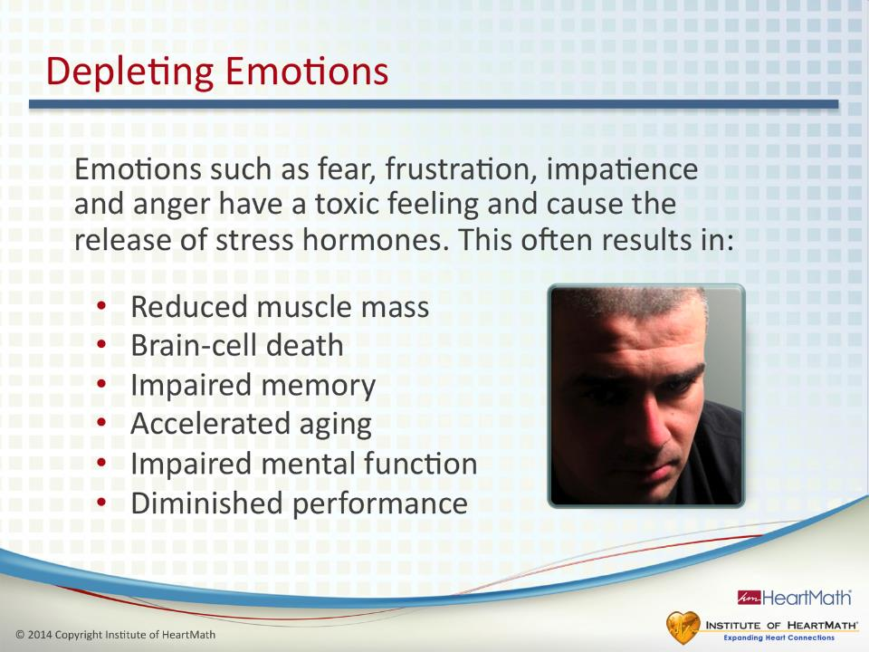
Notes:
Time: 1-2 minutes
Objective: Understand that emotions such as fear, frustration, impatience and anger can have negative consequences for our physiology, resilience, health and performance.
Key Points:
Some emotions, attitudes and feelings such as impatience, anxiety, frustration and sadness reduce resilience and affect your ability to think clearly and communicate effectively.
Ask: How clearly do you think when you feel overwhelmed or angry?
Big emotional upsets are not the only ones that drain your energy. More energy can be drained from the accumulation of quieter, ongoing emotional reactions. Both types affect your physiology, resilience health and performance.
(Point to slide.) Research shows that accumulated emotional reactions over time can have a number of unhealthy effects on the body.
Additional Key Points:
Some emotions are easy to identify. Others run below the radar.
Emotions such as impatience, frustration and anxiety set in motion a cascade of over 1,400 biochemical and hormonal changes that turn up energy production and utilization processes in our body. In other words, we expend a lot of energy.
The stress hormone, cortisol, which is produced even during a brief emotional reaction such as when we feel anxious or impatient, sets in motion a cascade of biochemical changes that can last up to 12 hours. That’s why emotional upsets during the day can have a disruptive effect on getting a good night’s sleep.
Transition: Contrast this with renewing emotions.

Slide 16
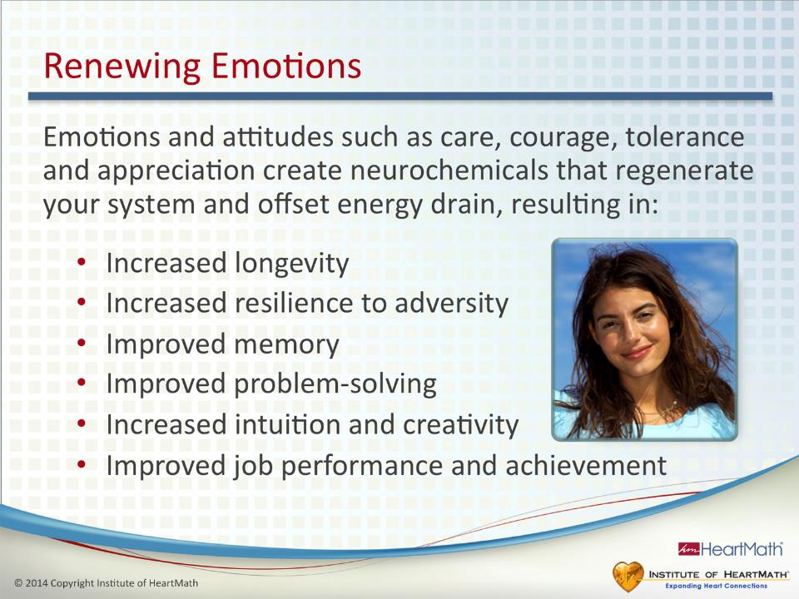
Notes:
Time: 1 minute
Objective: Understand that renewing emotions have beneficial effects on our physiology, resilience, health and performance.
Key Points:
•Renewing emotions, attitudes and feelings recharge your inner battery. Emotions such as enjoyment, appreciation, adventure, love, care, patience and tolerance have positive effects on us physiologically.
•Positive emotions build resilience and rejuvenate us mentally, emotionally and physically.
•Research shows … (Point to slide.)
Additional Key Point:
•Positive emotions also set in motion over 1,400 biochemical and hormonal changes, but the changes are a very different set of hormones than those caused by depleting emotions. One of these hormones is DHEA, which is associated with renewal, improved immunity and vitality.
Transition: It’s important to become smarter about how we spend our energy.

Slide 17
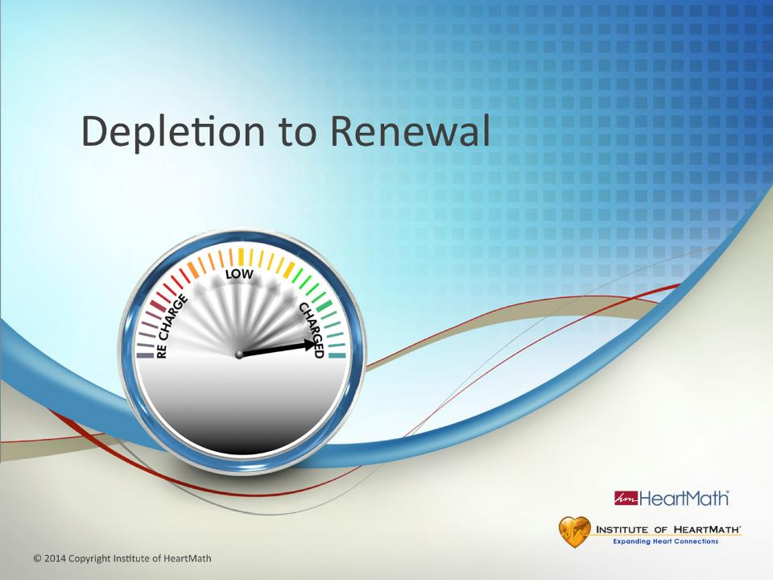
Notes:
Time: 30 seconds Objective: Introduce the Depletion to Renewal Grid.
Key Points: The Depletion to Renewal Grid is a research-based tool that provides a visual illustration of the relationship between typical emotional responses, their intensity and how those responses affect energy, performance, communication, resilience and the ability to self-regulate.
Transition: Emotions are not “good or bad” but they are primary drivers of physiology. This next exercise illustrates how different emotions – depleting or renewing – affect two primary systems. (Click to Grid).
Depletion to Renewal – Exercise
Time: Exercise total: 20 minutes Objectives: Identify two systems affected by emotions: the autonomic nervous system and hormonal system. Identify emotions and where they land on the Depletion to Renewal Grid. Engage the audience in self-awareness around what emotions they experience. Develop understand ing that depleting or renewing emotions have different effects on our physiology. Key Points:
(Show the slide and then blacken the screen. (Note: if you don't have a flip chart or white board, talk through the Grid using the slide.)
Take the audience through the Depletion to Renewal Grid using a Flip Chart or White board. Draw a vertical line as you explain the ANS: The vertical line represents the Autonomic Nervous System (ANS).
The ANS has two branches, one that speeds things up (increases heart rate) – sympathetic branch – and one that slows things down (decreases heart rate) – parasympathetic branch. (Write sympathetic – high heart rate at the top of the vertical line. Write parasympathetic – low heart rate at the bottom. Under parasympathetic, write relaxation). The ANS governs 90% of our body’s internal functions.
Draw a horizontal line in the middle of the vertical line as you explain: The horizontal line represents a key part of the hormonal system that regulates many other hormones and systems. Hormones are important because once secreted, some of them will remain active and circulating in the body for hours and have a long lasting effect. There are two key hormones that are impacted by the emotions we experience: Cortisol and DHEA.
(Write cortisol on the left side and explain), Cortisol is commonly known as the “stress hormone”. (Write DHEA on the right side and explain), DHEA is commonly known as the “vitality hormone”. (People need to know that cortisol is a hormone we need, but when we secrete too much or too little, there can be health implications—see references in the back of the guidebook.)
We all experience a wide range of emotions throughout a typical day. We may land all over the grid; we’re human so this is normal.
Our focus today is to identify those emotions, where they land on the grid and to learn techniques to help us cultivate more renewing emotions to enhance our resilience and charge our inner battery. (Trainer solicits one or two examples for each quadrant. Start in the upper LEFT quadrant of the Grid and work your way around to the upper right.)

Slide 18
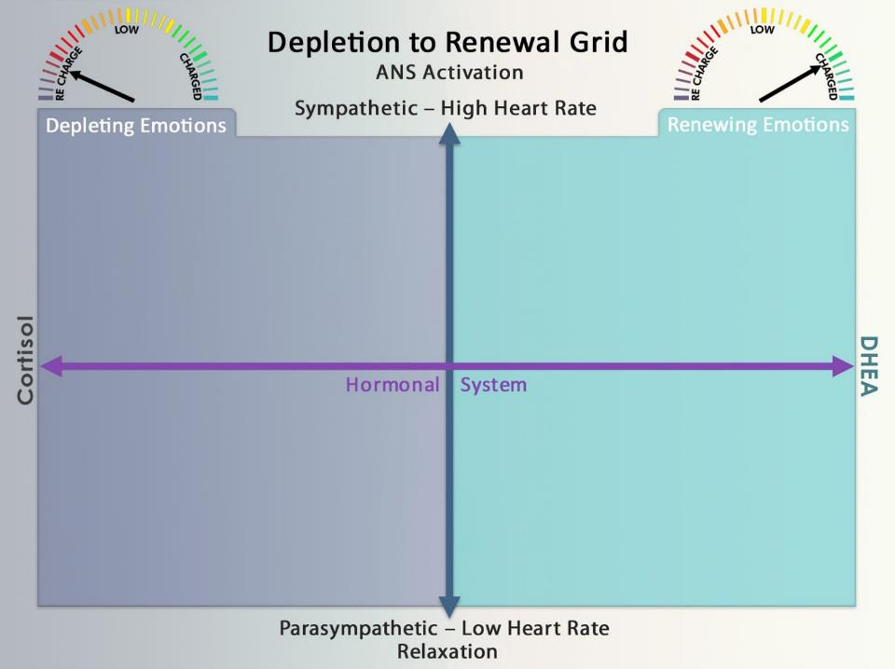

Notes:
Exercise:
Now ask the participants to go to their guidebook and take 2-3 minutes to fill in the four quadrants.
Ask: Ask yourself what emotions you have experienced over the last week or so that depleted you (drained your inner battery) and what emotions renewed you (charged your inner battery). Any questions?
If needed, share more examples that could help participants fill in their Grid:
Frustrated in a meeting
Angry over a communication
Sad because a friend is ill
Depressed because you don’t have enough family time
Peaceful or calm at the end of a good day
Excited after hearing good news
Exhilarated after a great ski run
(Give the audience 3-4 minutes to fill out their grid).
Ask the participants to bring their attention back to the front of the room.
(Debrief by gathering examples from the participants, starting in the upper left and working your way around to the upper right. Get as many examples as you can to fill in the Flip Chart.
(NOTE: If someone says exhausted, tired, etc., in any of the left hand quadrants, coach them to find out the accompanying emotion. Write only the emotion in the quadrants.)
(If someone says ‘relaxed’ for the lower right quadrant, coach them to find out the renewing emotion they experienced when they were relaxed. This is a time you could remind them of the difference between coherence and relaxation. Write only the emotion in the lower right quadrant.)
(Point to the entire left side of the grid):
Say: The entire left side of this grid represents the depleting emotions – draining our inner battery.
(Point to the entire right side of the grid):
Say: The entire right side represents the renewing side of the grid – charging our inner battery.
(When you finish filling out the Grid:)
Ask four questions:
What emotions do you experience regularly that are renewing?
What emotions do you experience regularly that are depleting?
In which quadrant do you spend most of your time?
Where would you like to spend more time?
The goal is to spend more time on the right side of this grid than the left. Life happens so we won’t always be able to do that, but the more time we spend on the right side, we increase our inner battery and build resilience.
Transition: We have already learned two intelligent energy self-regulation techniques that can help bring synchronization to the Autonomic Nervous System: Heart-Focused Breathing and Inner-Ease; now let’s add another self-regulation technique to add even more coherence to our physiology to balance the two key hormones that are affected by our emotions.
(Now, point to the upper LEFT quadrant of the Grid):
Ask: What is one example of a depleting emotion that speeds up heart rate?
Now let’s move down to the lower LEFT quadrant.
Ask: What would be one depleting emotion where we experience a low heart rate?
(Point to the lower RIGHT quadrant):
Ask: What is one example of a renewing emotion that is accompanied by a low heart rate?
(Point to the upper RIGHT quadrant):
Ask: How about one example of a renewing emotion that is accompanied by a high heart rate?

Slide 19
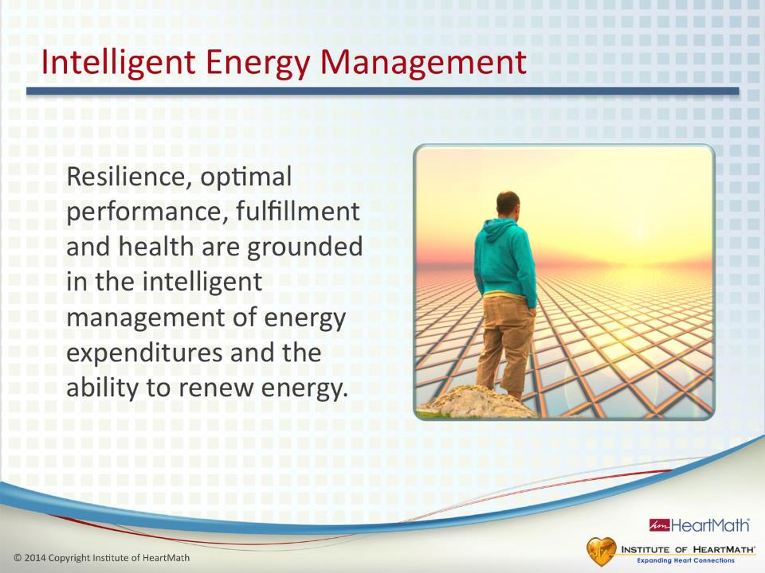
Notes:
Time: 30 seconds
Objective: Introduce the concept of intelligent energy management.
Key Point:
•Building and sustaining resilience is the intelligent management of our energy expenditures and our ability to recharge more quickly.
Transition: To more intelligently manage our energy, we have to become more aware of our unnecessary energy expenditures.

Slide 20
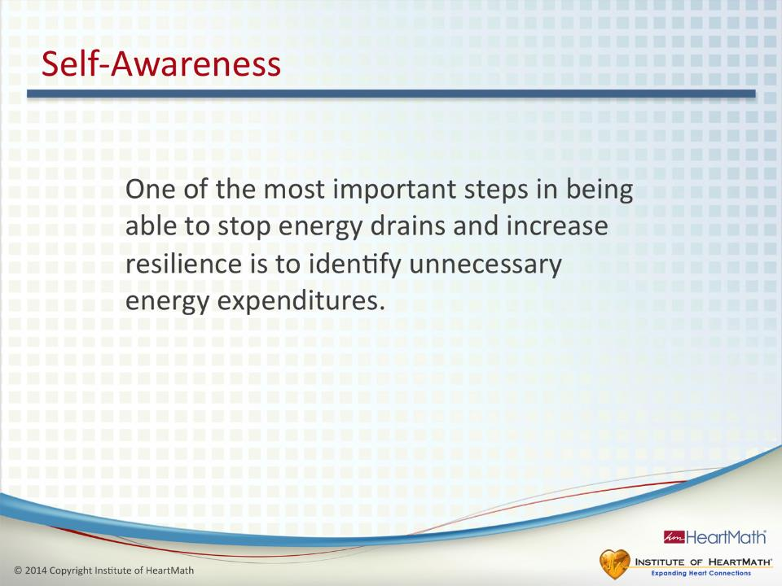
Notes:
Time: 6-8 minutes
Objective: Inform participants that the first step in increasing resilience is identifying unnecessary energy expenditures.
Key Points:
•Identifying where you are draining your energy is the first step in building resilience.
•You can’t plug leaks if you don’t know where you are draining your energy.
•Let’s turn to the Energy-Depleting Situations Exercise in the Guidebook.
•Identify situations, events, interactions or attitudes that drain your inner battery and write them down.
•Identify or name the feeling or emotion you experienced for each: for example, impatience, resentment, anxiety or anger.
•Identify your current solution for handling those situations.
•(Give participants a couple of minutes to complete exercise, then debrief them.)
•Ask: What are some examples of unnecessary energy expenditures?
Transition: Let’s start with a couple of techniques designed to help you plug energy leaks and recharge your inner battery.
Exercise

Slide 21
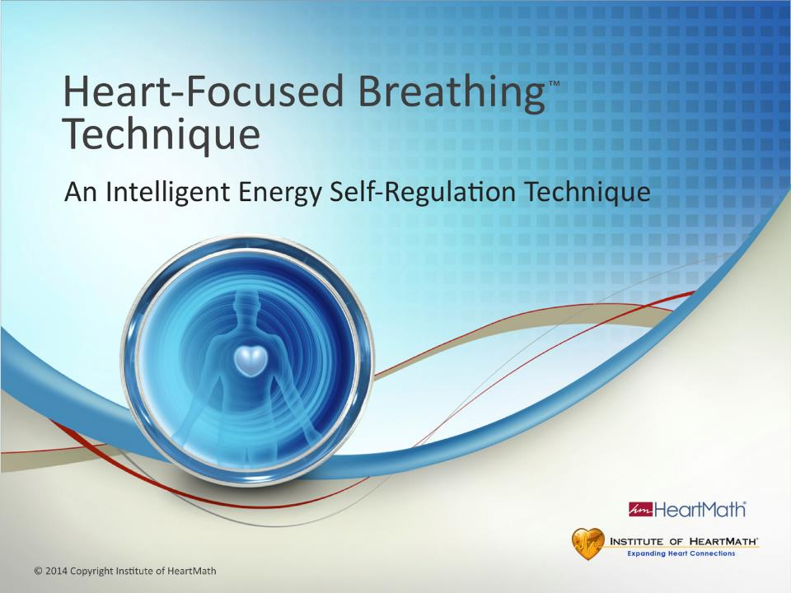
Notes:
Time: 30 seconds
Objective: Introduce the Heart-Focused Breathing module.
Key Point:
Heart-Focused Breathing is an easy-to-use, energy-saving self-regulation strategy designed to reduce the intensity of a stress reaction and to establish a calm, but alert state.
Transition: Ask: How many of you have learned some type of breathing technique?

Slide 22
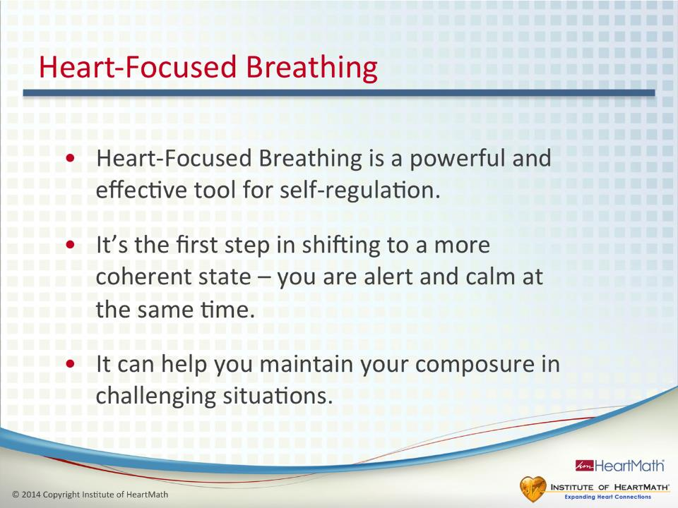
Notes:
Time: 1-2 minutes
Objective: Introduce the Heart-Focused Breathing Technique.
Key Points:
Ask: What are some breathing techniques you have learned?
Ask: How many of you have kids? If they hurt themselves or are upset, what do you do? Often times we suggest they take a couple deep breaths to calm down, which can help them change their focus. It is interesting that adults forget to do this for themselves.
Breathing techniques have been around a long time and are widely used because they are effective.
We can gain benefit from conscious breathing if we use it to help us shift into and sustain a more balanced state, understanding that breathing is only the start of what we call the coherence-building process.
Heart-Focused Breathing is the first step in regulating our energy. We will build on this step in the techniques that follow.
Transition: This is a deceptively simple technique. Once you gain experience in using it, you may find, as many people do, it can be a powerhouse tool. Let’s go over the Heart-Focused Breathing Technique.

Slide 23
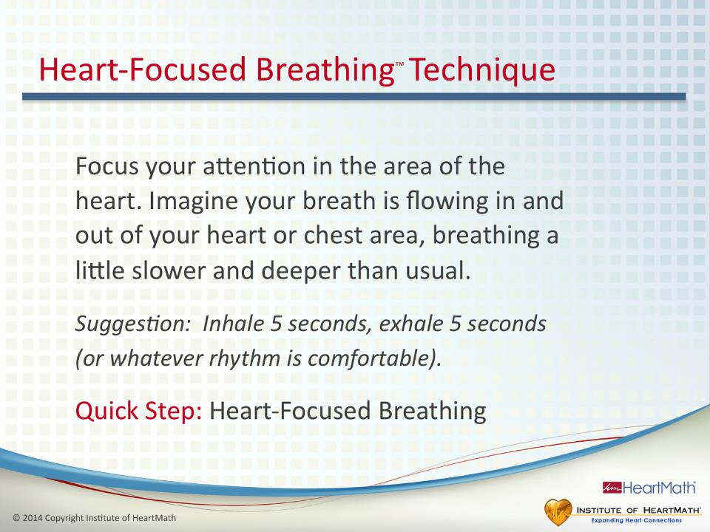
Notes:
Time: 5 minutes
Objective: Learn and practice the Heart-Focused Breathing Technique.
Key Points:
Let’s practice the Heart-Focused Breathing Technique together as I read it to you.
Read the step: Focus your attention in the area of the heart. Imagine your breath is flowing in and out of your heart or chest area, breathing a little slower and deeper than usual.
Suggestion: Inhale 5 seconds, exhale 5 seconds (or whatever rhythm is comfortable.)
Try practicing Heart-Focused Breathing with your eyes open. Soon you will be able to do it on the go and no one will know you are doing it.
Ask: Why do we focus our attention on the area of the heart? It has been demonstrated that when we focus our attention on a specific area of our body, it leads to measurable physiological changes in that area. In this case, shifting attention to the heart area helps shift our heart rhythms into a more coherent state. It also draws our focus of attention away from an issue, which further helps calm our thoughts and stabilize our emotions.
(Helpful tip: If participants have difficulty focusing on the heart area, have them shift their focus to their left index finger and wiggle it. Then have them shift their focus to their right big toe and wiggle it. Explain that this is what we mean by focusing attention. Now have them focus in the area of the heart.)
Heart-Focused Breathing creates an inner pause. In that pause you can become aware that you have a choice of how you want to respond. In other words, you don’t have to respond in an automatic, knee-jerk kind of reaction or behavior. That new choice can change the trajectory of the moment and the outcome.
Use Heart-Focused Breathing in the moment to help take the intensity out of or turn down the volume of a stress reaction. You can use it, for example, to increase your composure before a meeting or conversation.
The Quick Step is simply Heart-Focused Breathing. Once you are comfortable doing the technique, that’s all you will need to remember. Transition: Let’s identify situations, events, interactions or attitudes that you know renew your energy.
OPTIONAL Self-Awareness EXERCISE – Renewing Time: 5-7 minutes Objective: Inform participants that they can recharge their inner batteries to build resilience.
Key Points:
Let’s turn to the Energy-Renewing Situations Exercise in the guidebook.
Identify situations, events, interactions or attitudes that give you the feeling of renewal and recharging your inner battery.
Next identify or name the feeling or emotion you experienced for each, for example, contentment, joy, appreciation, care or excitement.
(Give participants a couple of minutes to complete exercise, then debrief them).
Ask: Did you notice that emotions can affect you quite differently: Some are depleting and some are renewing?
Transition: In challenging situations Heart-Focused Breathing often is the first step that will help us calm down. Another self-regulation technique that adds ease to your daily routine is the Inner-Ease Technique. Let’s review it now:

Slide 24
How Does Heart-Focused Breathing Affect Your Heart Rhythm?
With slow, deep breathing….
Inspiration: heart beats faster
(sympathetic activation)
Expiration: heart beats slower
(parasympathetic activation)
Notes:
24

Slide 25
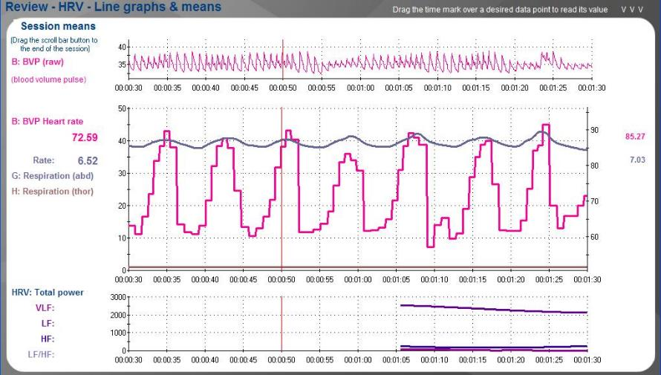
Respiratory Sinus Arrhythmia
Notes:
This is known as COHERENCE

Slide 26
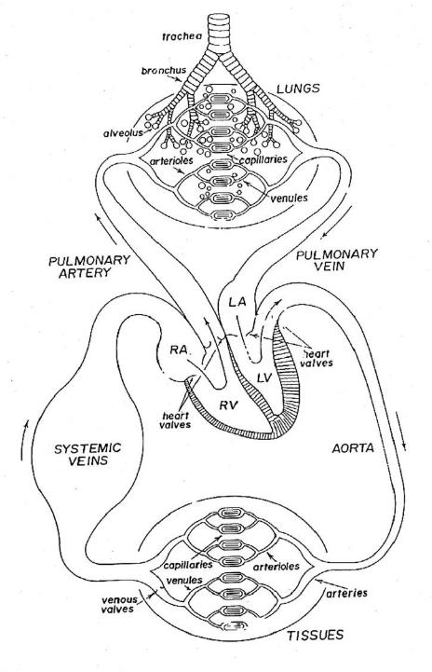
Physiological Mechanisms of
of Respiratory Sinus Arrhythmia

Slide 27
Mechanisms for Respiratory Sinus Arrhythmia
Inspiration reduces intrathoracic pressure leading to increased venous return.
Right atrium stretches.
Impulses from the right atrial receptors produce the “Bainbridge reflex”:
  -Increased right atrial pressure → stimulation of stretch receptors (=volume receptors) in the atrial wall
  -Produces discharge of impulses along afferent vagal fibers to the medulla oblongata
  - Leads to stimulation of the vasomotor centre
  → efferent impulses along the sympathetic nerves to the heart → increase of heart rate.

Slide 28
  Mechanisms for Respiratory Sinus Arrhythmia
  On exhalation, extra blood from lungs enters left heart and is pumped into aorta so arterial pressure increases.
  Impulses from the arterial baroreceptors of the aortic arch & carotid sinus respond to increased arterial pressure.
  Parasympathetic (vagal) nerves are stimulated and heart rate decreases during expiration.
  Also intrathoracic pressure increases leading to decreased venous return and no right atrial stretching.

Slide 29
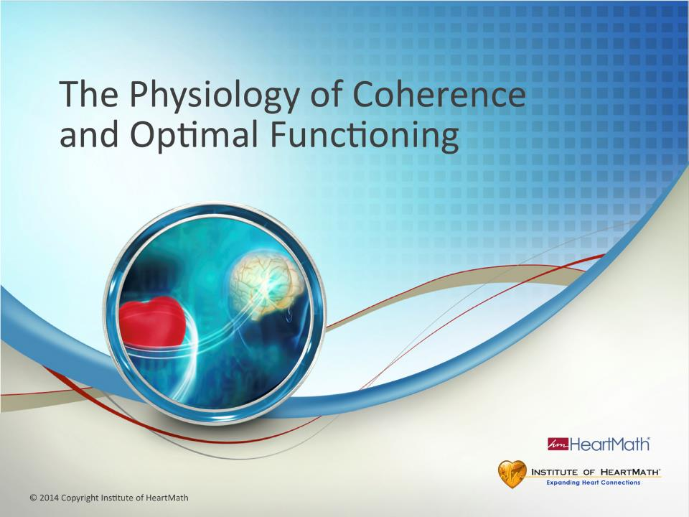
Notes:
Time: 1 minute
Objective: Introduce the science module: The Physiology of Coherence and Optimal Functioning.
Key Points:
The team of researchers at the Institute of HeartMath has researched the physiology of resilience and optimal functioning for over 20 years.
The physiology of optimal functioning is a broad topic. We’re going to focus on several key points, some which may be new to you and that you may find interesting and helpful.
There’s an important term that is fundamental to resilience, optimal functioning and being at our best. That term is coherence.
Ask: What does coherence mean to you?
Transition: Let’s see what coherence is.

Slide 30
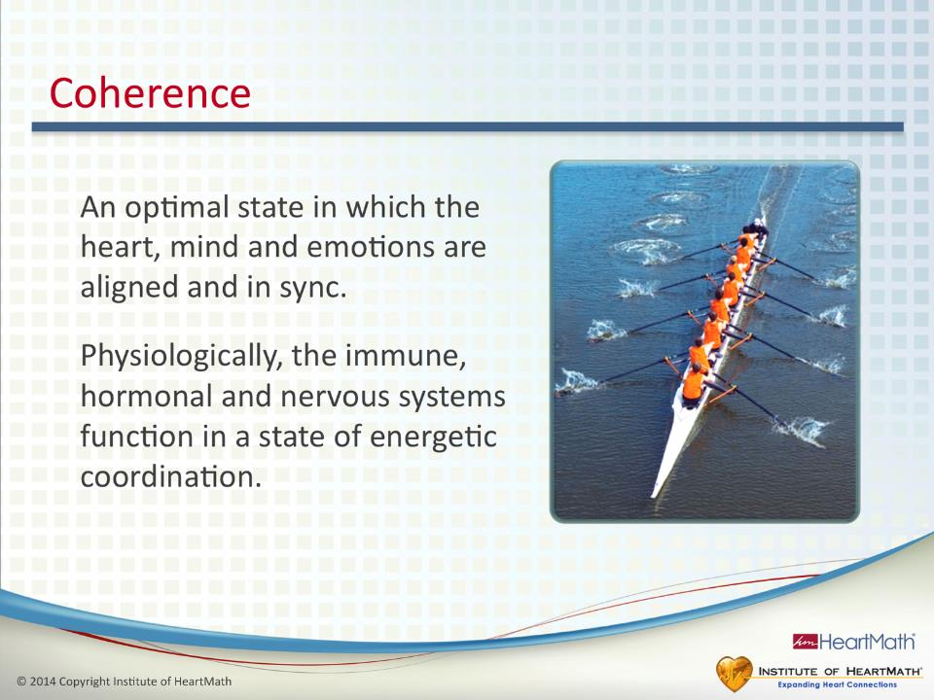
Notes:
Time: 3 minutes
Objective: Explain what coherence means in common, everyday terms and its benefits.
Key Points:
One common use of the word coherence occurs in the context of a coherent sentence or coherent speech in which the words come together and make sense. If someone has had too much alcohol to drink, we often say that person is incoherent and not making sense.
Physiologically, coherence is used to describe a state in which the immune, hormonal and nervous systems function in a state of energetic coordination.
Coherence is an optimal state in which the heart, mind and emotions are in sync and balanced.
A major source of stress for many people, however, is not having their thoughts and emotions in sync and aligned.
Ask: Have you ever had the experience of your mind telling you one thing and your emotions telling you another?
When you are energetically centered or coherent, you have greater mental and emotional flexibility and composure.
Sustained coherence builds your resilience capacity and is a regenerative state that can quickly recharge your inner battery and bring more stability to your system.
Additional Key Points:
Coherence also is used in science to describe when separate entities or systems function harmoniously and in sync such as when flocks of birds or schools of fish move in unison as if they are one organism.
Transition: To understand coherence and how it affects us, we need to look at a key physiological system.

Slide 31
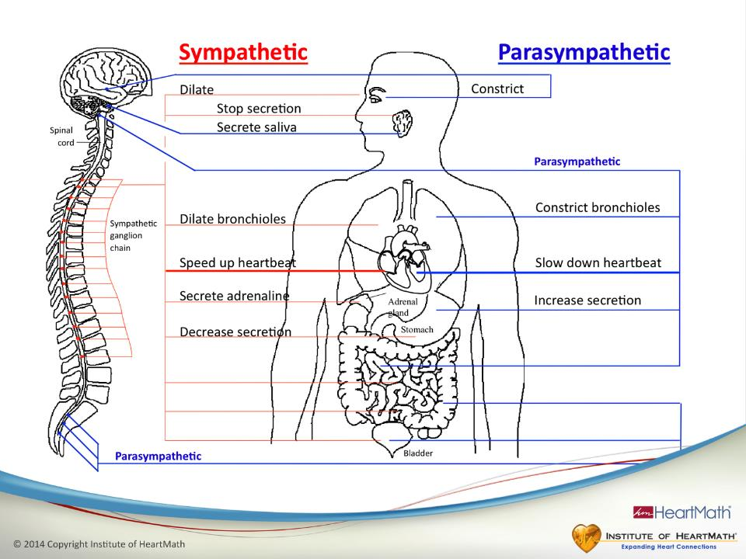
Notes:
Time: 2 minutes
Objective: Give a basic description of the autonomic nervous system (ANS).
Key Points:
One reason it’s important to talk about the autonomic nervous system (ANS) is because it regulates over 90% of our body’s internal functions, including breathing, digestion, heart rate, immune system, important aspects of the hormonal system, alertness and sleep.
The ANS has two separate branches: the sympathetic and parasympathetic.
The sympathetic branch acts like a gas pedal, speeding up internal processes and mobilizing energy. The parasympathetic branch acts like a brake pedal, slowing down internal processes.
Both branches of the ANS connect to the heart.
This is important because any change in activity in either branch affects the way the heart beats on a beat-to-beat basis, as we will see shortly.
Any emotion we feel changes the activity in the branches of the ANS and has a major influence on all of our body’s systems.
Transition: The ANS connects the heart and brain. In fact, the heart and brain are strongly interconnected and this has some important and surprising effects on our mental functions.

Slide 32
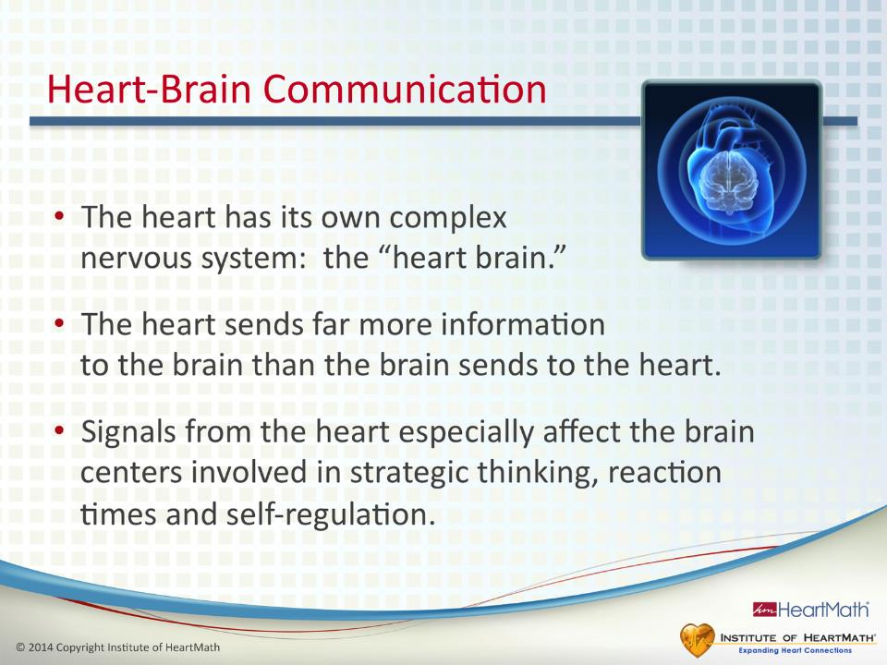
Notes:
Time: 1 minute
Objective: Introduce the concept of heart-brain communication.
Key Points:
The heart has its own complex nervous system, which can be thought of as the heart brain. This understanding comes from research in a field called neurocardiology.
The heart sends far more information to the brain than the brain sends to the heart. This has been known since the late 1800s but has been largely forgotten or ignored.
The neural signals that the heart sends to the brain affect brain centers involved in decision-making, creativity and self-regulation.
Transition: Earlier we said both branches of the ANS connect to the heart. This means that any change in the activity in the ANS affects the heart on a beat-to-beat basis. This is called heart rate variability.

Slide 33
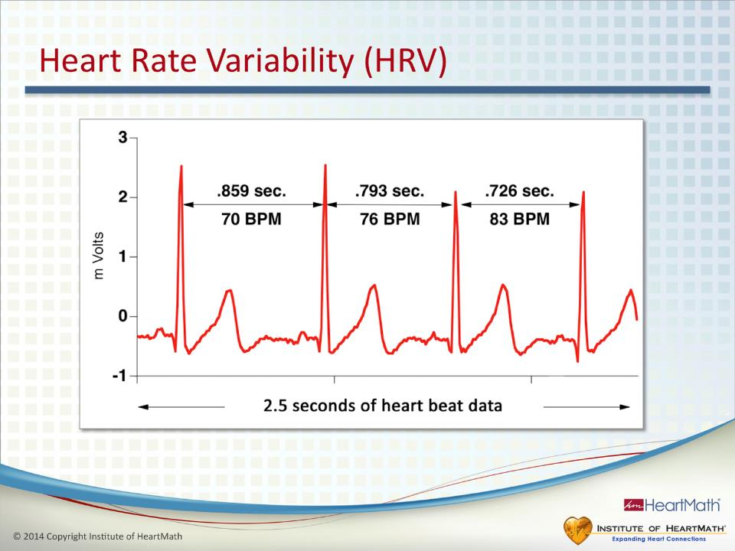
Notes:
Time: 1 minute
Objective: Understand that heart rate varies with every heartbeat.
Key Points:
Heart rate is simply the number of times the heart beats in a minute.
It used to be commonly thought that the heart beats at a steady rhythm.
It is now known that in a healthy, resilient person, the amount of time between each heartbeat varies.
This natural beat-to-beat variation is always occurring, whether you’re sitting still, sleeping, answering emails or driving down the road.
(Refer to the slide.) This is an electrocardiogram showing four heartbeats.
There is a different interval, or amount of time between each heartbeat. In other words, the time between heartbeats varies, or changes. That is what is meant by heart rate variability.
Transition: We just looked at four heartbeats. Now we want to look at a longer series of heartbeats.

Slide 34
Connection between Cardiac Intrinsic Nervous System and HRV
Hormonal, chemical and pressure information is translated into neurological impulses by the heart's intrinsic nervous system and is sent from the heart to the brain through several afferent pathways.
The resulting integrative signal that encompasses the continually changing chemical, hormonal and dynamic structural properties of the cardiac tissue is the Heart Rate Variability.

Slide 35
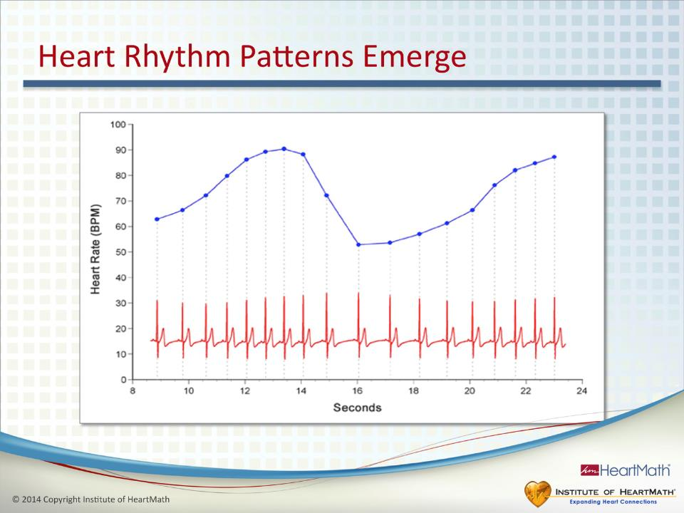
Notes:
Time: 1 minute
Objective: Help participants understand how beat-to-beat variability creates the heart’s rhythm.
Key Points:
Here we are looking at the beat-to-beat changes over a longer time period.
The beats-per-minute equivalent (BPM) for each pair of heartbeats is shown on the chart as a blue dot.
The blue line that connects the blue dots forms the heart rhythm pattern.
Each upslope represents an increase in heart rate, for example, a series of heartbeats speeding up.
Each downslope represents a decrease in heart rate, for example, a series of heartbeats slowing down.
Transition: Next, we’re going to look at a few minutes of data from someone in different emotional states.

Slide 36
Connection between Cardiac Intrinsic Nervous System and HRV
When the HRV signal reaches the limbic and cortical areas of the brain, it can be modified (with or without conscious intention).
The modified signal is sent back to the intrinsic nervous system of the heart and other organs via the ANS resulting in changes in physiological function.

Slide 37
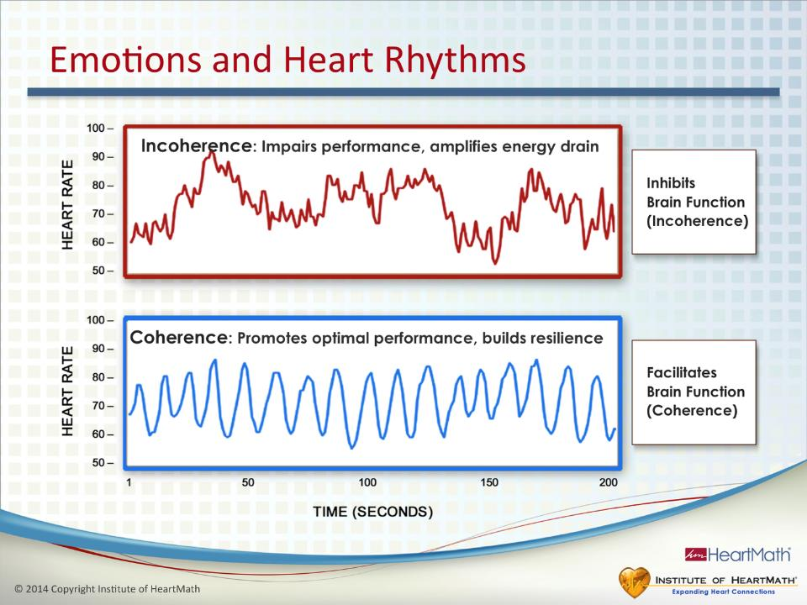
Notes:
Time: 5 minutes Objectives: Explain how emotions are reflected in the patterns of our heart rhythms. Explain that HRV patterns can be coherent or incoherent at low or high heart rates. Explain that a subject’s coherent or incoherent HRV patterns can sometimes have the same amount of variability. Explain that the HRV patterns in heart rhythms indicate whether a subject is in a coherent or incoherent state. Instill confidence in participants that with practice, they can learn to shift from incoherence to coherence, anywhere, anytime.
Key Points:
The two heart rhythms on this slide belong to the same person.
Ask: (Refer to slide.) What do you think the person was doing that created the top heart rhythm pattern? (Pause.) She was instructed to feel frustration. When she shifted to feeling frustrated, her heart rhythms became chaotic-looking.
Depleting emotions such as frustration, impatience or anxiety are reflected in an irregular, chaotic HRV pattern, indicating that the activity between the sympathetic and parasympathetic systems is out of sync.
Scientists call this an incoherent heart rhythm.
This is similar to driving a car with one foot on the accelerator and riding the brake with the other foot. Remember, the sympathetic branch speeds processes up and is like the gas pedal. The parasympathetic branch is like the brake pedal: It slows down processes.
Ask: Why is this not a good idea? Driving in this manner leads to: A jerky ride., Increased wear and tear on the car, Decreased gas mileage and an inefficient use of energy, which is analogous to a rapid energy drain when we’re frustrated, etc.
The heart sends a lot of information to the brain through the ANS. Incoherent heart rhythms inhibit brain function, impairing performance and amplifying energy drains.
Ask: What do you think the person who created the bottom heart rhythm pattern was doing? (Pause.) She was asked to feel appreciation. When she shifted into feeling appreciation, her heart-rhythm pattern changed.
Renewing emotions such as appreciation create a more ordered, harmonious pattern reflecting that the activity between the sympathetic and parasympathetic systems is in sync.
Scientists call this a coherent heart rhythm.
Incoherent rhythms reflect out-of-sync activity in the two branches of the ANS while coherent rhythms reflect synchronized activity.
Coherence helps promote optimal performance and brain function and builds resilience.
A coherent state is not necessarily the same as relaxation. In other words, you can have a high heart rate or a low heart rate and still exhibit an ordered, coherent pattern.
People can be relaxed, which is indicated by a low heart rate, but still be rehashing and processing an argument from earlier in the day. Their systems will be incoherent and they will be draining a lot of energy.
The coherence techniques you’re learning enable you to shift into a coherent and composed state anytime, anywhere.
Transition: HRV is a very important measure of our overall health and resilience.

Slide 38
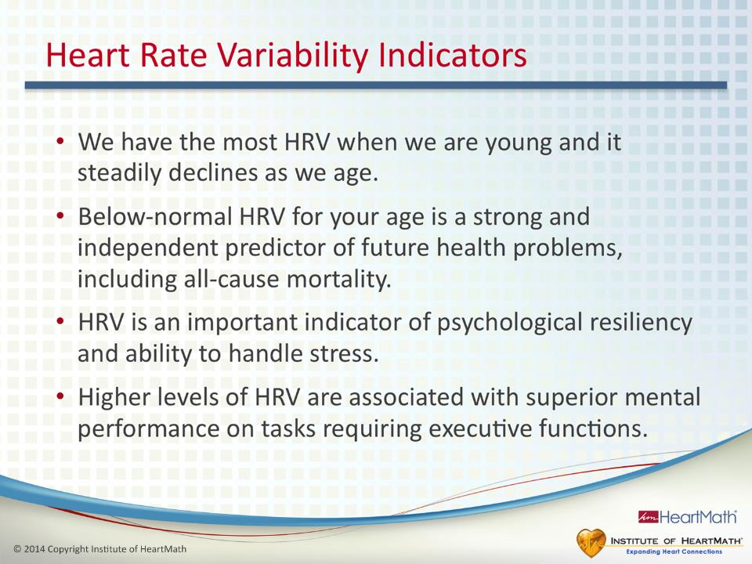
Notes:
Time: 1 minute
Objective: Explain the importance of HRV.
Key Points:
We have the most HRV when we are young and it steadily declines as we age.
Below-normal HRV for a given age is a strong and independent predictor of future health problems, including all-cause mortality.
HRV is an important indicator of both physiological resilience and behavioral flexibility, meaning that it influences our ability to handle stress and challenges.
A number of studies have shown that higher levels of HRV are associated with superior mental performance on tasks requiring executive functions.
Transition: Let’s look at a few minutes’ worth of data that illustrates the difference between high and low ranges of HRV.

Slide 39
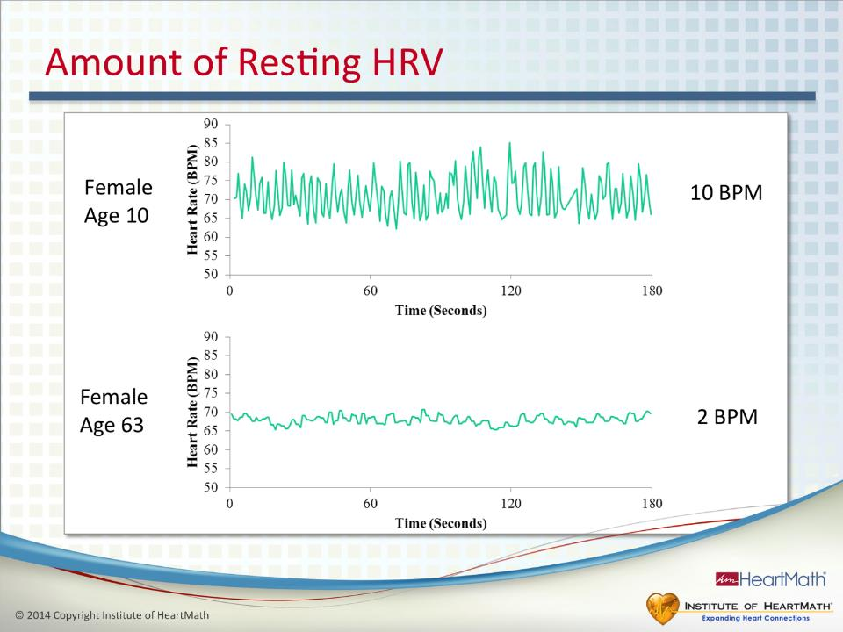
Notes:
Time: 1 minute
Objective: Help participants understand the difference between high and low HRV and that it declines with age.
Key Points:
As mentioned before, we have the most HRV when we are young, and then it steadily declines as we age.
Here is an example of HRV during a resting state for a young girl and a woman in her 60s. (The 10 BPM listed at the top and the 2 BPM listed at the bottom is the average heart rate for each subject over the 180 seconds of data).
There is more naturally occurring variability in the younger person, meaning there is a wider range from the top of the heart rhythm (the peak) to the bottom of the heart rhythm (the valley).
Researchers can tell in healthy and resilient individuals how old they are within about two years by measuring the amount of the person’s HRV over a 24-hour period.
HRV that is lower than it should be for a given age is an indicator of accumulated energy drain and faster aging, which is predictive of future health challenges.
Transition: Do you remember that we talked about heart-brain communication and how the heart rhythm patterns affect mental activity?

Slide 40
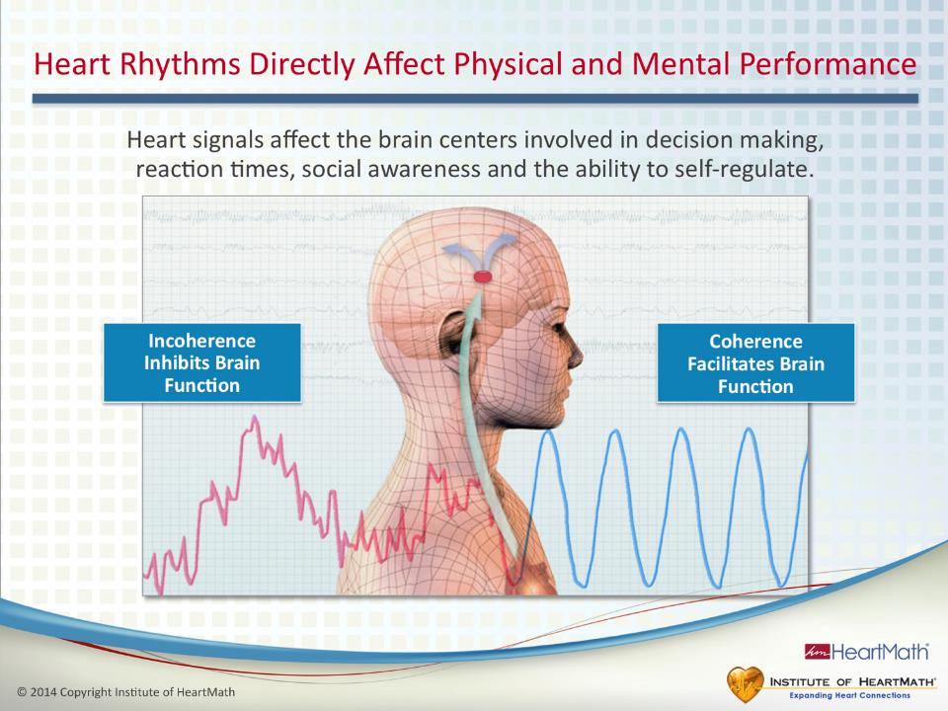
Notes:
Time: 4 minutes
Objective: Understand how the heart’s neural activity can inhibit or facilitate mental function and performance.
Key Points:
Neural activity from the heart travels up to the brain via the ANS and influences brain centers associated with thinking, decision-making, reaction times, long- and short-term memory and self-regulation.
The thalamus, a key brain center, is involved in optimal function and is strongly affected by the neural signals from the heart. One of the many roles of the thalamus is to synchronize the neural activity of the entire brain, including the cortex, which is the thinking part of the brain. The cortex is where the executive functions take place: the ability to plan and set goals, think abstractly and creatively, self-regulate and see how our actions and behaviors will affect our future (foresight).
Incoherent heart rhythms interfere with the thalamus’s ability to synchronize cortical activity, causing what scientists call cortical inhibition.
Ask: Have you ever been upset and reacted to someone and said or done something you later regretted? When this happens, has it typically lead to more stress and wasted time? How many times have you done this with the same person? In response to the same issue?
Anger, frustration and other depleting emotions can often lead us to do stupid things. Sometimes we even say, “Where was my brain?” That is because the cortex was inhibited. We literally can’t think clearly when we feel stressed.
On the other hand, coherent heart rhythms improve the thalamus’s ability to synchronize cortical activity, resulting in what scientists call cortical facilitation. Cortical facilitation means all of the executive functions are optimized.
Transition: In other words, when we’re coherent we can make smarter choices, improve reaction times, enhance focus, creativity and the ability to problem-solve.

Slide 41
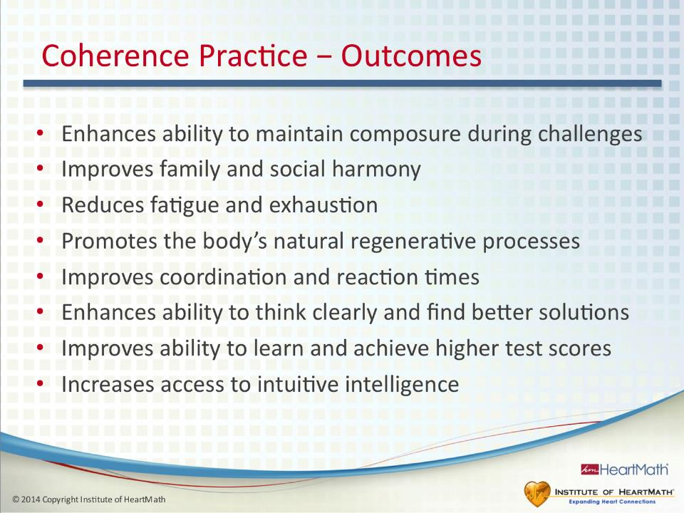
Notes:
Time: 2 minutes
Objective: Describe to participants the benefits of practicing the HeartMath coherence- and resilience-building techniques that have been validated in various research studies.
Key Points:
(Refer to slide.) Practicing coherence- and resilience-building skills leads to many physiological, psychological and relational benefits:
Enhances ability to maintain composure during challenges.
Improves family and social harmony.
Reduces fatigue and exhaustion.
Promotes the body’s natural regenerative processes.
Improves coordination and reaction times.
Enhances ability to think clearly and find better solutions.
Improves ability to learn and achieve higher test scores.
Increases access to intuitive intelligence.
Transition: Let’s discuss how depleting and renewing emotions affect the two primary systems the body uses to regulate our energy.

Slide 42
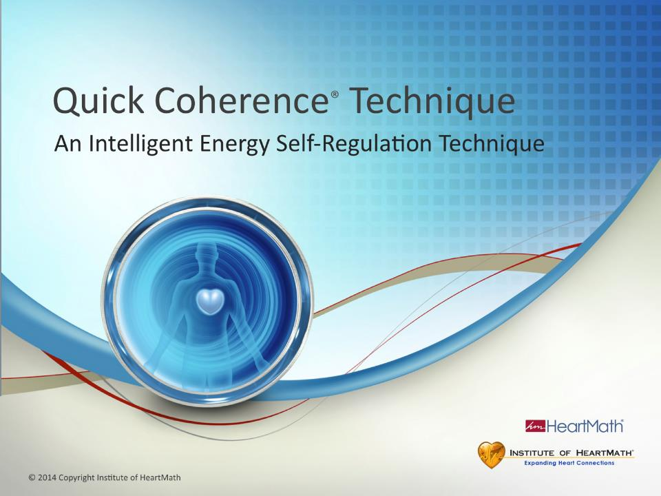
Notes:
Time: 15 seconds
Objective: Introduce the Quick Coherence Technique.
Key Point:
The Quick Coherence Technique is a simple and effective coherence-building skill.
It builds on the Heart-Focused Breathing™ Technique by including a renewing emotion to begin the resilience-building process.
Transition: This technique helps us more intelligently regulate our energy expenditures and increase resilience capacity.

Slide 43
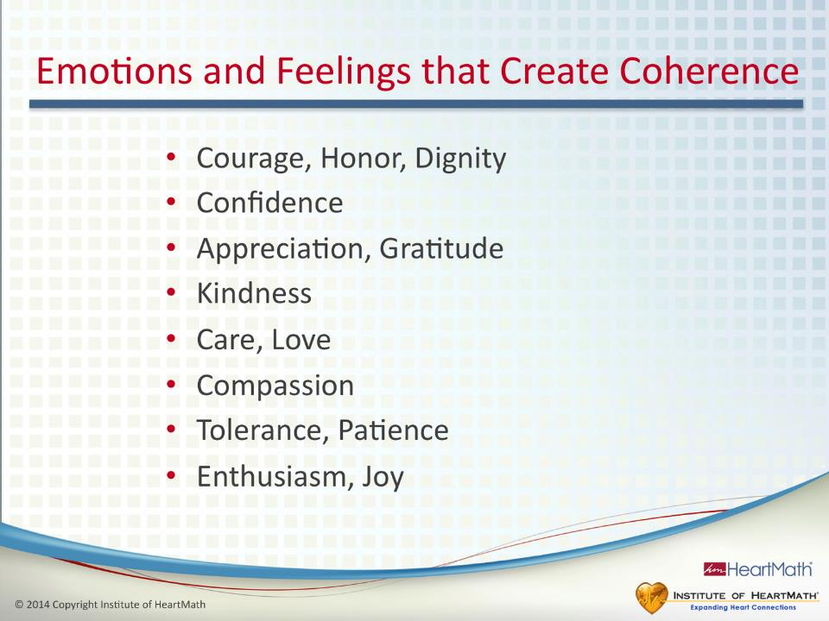
Notes:
Time: 4 minutes
Objective: Help participants understand that renewing emotions increase coherence and composure. Help them identify renewing emotions and have them practice activating one.
Key Points:
Renewing emotions such as appreciation, courage, care , integrity and compassion shift your heart rhythms into a more coherent rhythm.
(Point to right side of the Grid if you have done the Grid exercise.)
Renewing emotions rejuvenate you mentally, emotionally and physically and recharge your inner battery.
One example of how you can intentionally create more coherence throughout the day is by practicing being more tolerant and patient and taking time to appreciate the positive things in your life.
Ask: What are some examples of renewing emotions you experience?
(If they have done the Grid exercise, you can refer them back to the emotions they identified on the right side.)
Try to experience the feeling you have for someone you love, a pet you care about, special place you enjoy or an accomplishment, or focus on a feeling of calm or ease.
(Optional Exercise: Have participants write their list in the guidebook in the Quick Coherence section.)
Experiencing a feeling such as one of those is what we call “activating” a positive or renewing feeling.
It’s helpful to note that any renewing emotion can generate coherence. Sometimes it’s easier to access one over another, so building a repertoire of different positive emotional responses can help you quickly flip the switch back to coherence.
Transition: Now let’s do the Quick Coherence Technique together, activating a renewing feeling to reach a deeper level of coherence.

Slide 44
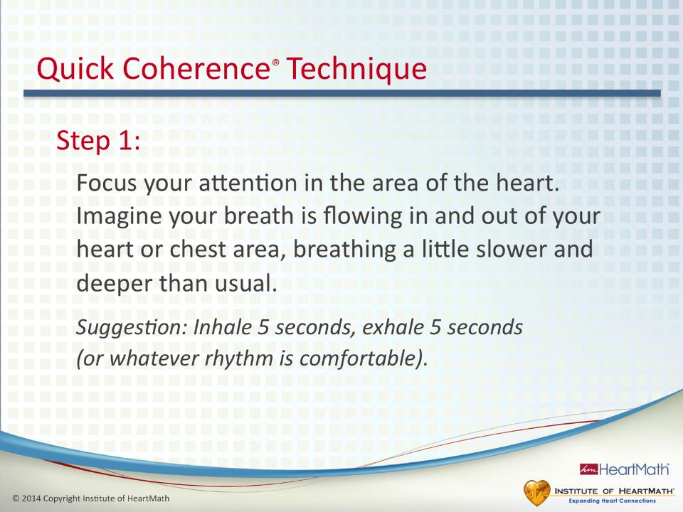
Notes:
Time: 1 minute
Objective: Introduce Step 1 of the Quick Coherence Technique.
Key Points:
(Read the Quick Coherence steps aloud.)
Step 1: Focus your attention in the area of the heart. Imagine your breath is flowing in and out of your heart or chest area, breathing a little slower and deeper than usual.
Suggestion: Inhale 5 seconds, exhale 5 seconds (or whatever rhythm is comfortable).
Focusing your attention on the heart area helps you center and get coherent.
This first step is Heart-Focused Breathing.
Transition: Let’s add an important step to help reach a deeper level of coherence.

Slide 45
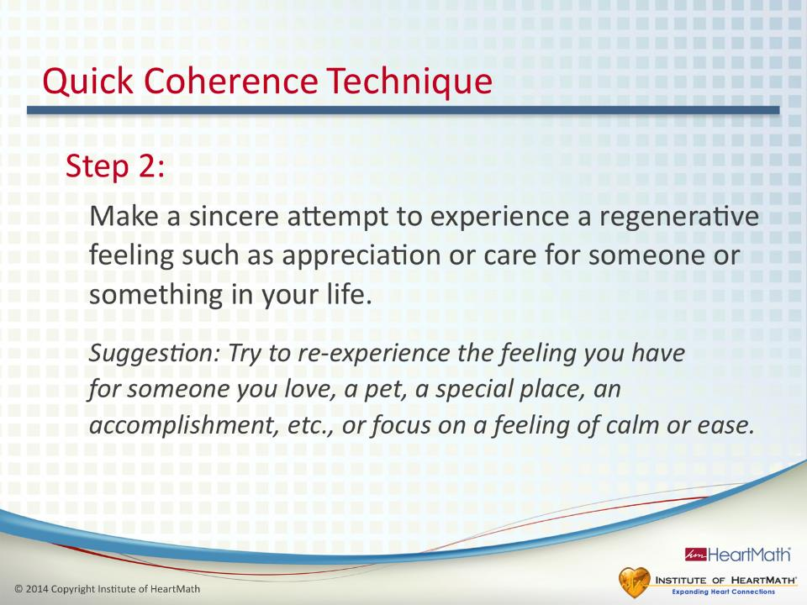
Notes:
Time: 1 minute
Objective: Introduce Step 2 of the Quick Coherence Technique.
Key Points:
Step 2: Make a sincere attempt to experience a regenerative feeling such as appreciation or care for someone or something in your life.
Suggestion: Try to re-experience the feeling you have for someone you love, a pet, a special, an accomplishment, etc., or focus on a feeling of calm or ease.
Transition: Once you understand how to do each of the steps, all that you have to remember are the Quick Steps.

Slide 46
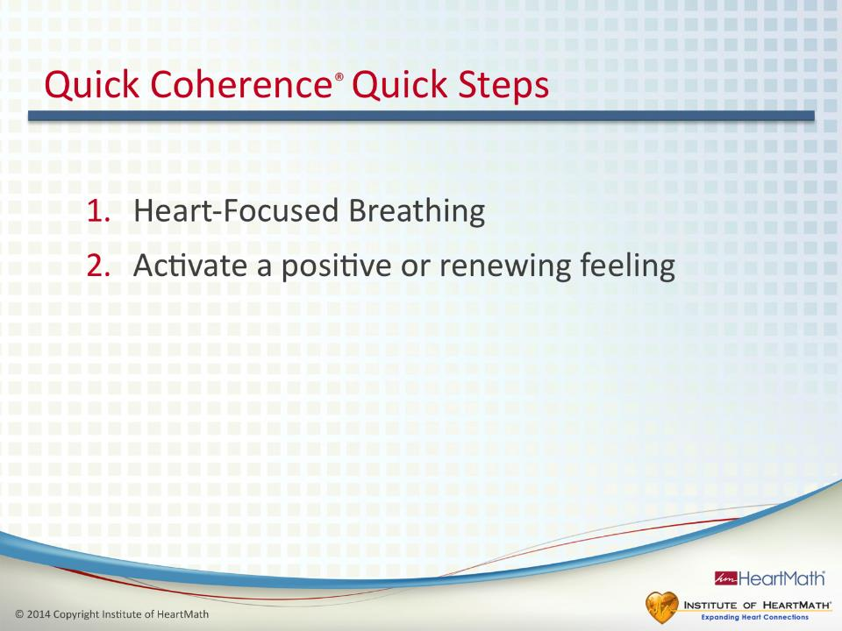
Notes:
Time: 1 minute
Objective: Introduce the Quick Coherence Quick Steps and practice the Quick Coherence Technique.
Key Points:
Once you learn the Quick Coherence Technique, you need only remember these Quick Steps.
1. Heart-Focused Breathing
2. Activate a positive or renewing feeling
(Read the Quick Coherence Technique steps again and ask them to practice the steps as you read them.)
(Optional: Ask participants to share their experience of doing the technique. If you have introduced the Depletion to Renewal Grid, ask them which quadrant they are in now.)
Transition: Let’s see what happens to our heart rhythms when we practice the Quick Coherence Technique.

Slide 47
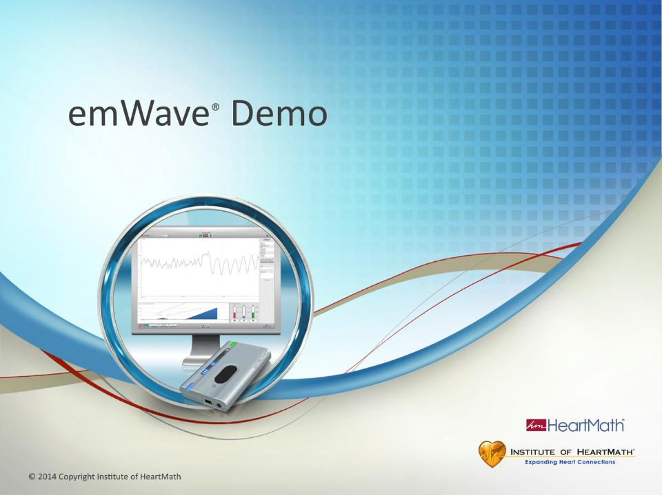
Notes:
Time: 5-7 minutes
Objective: Demonstrate the emWave Pro technology, showing how emotions affect heart rhythms in real time and how using the Quick Coherence Technique can quickly increase coherence.
Key Points:
(Switch from the PowerPoint application to the emWave software.)
(Ask for a volunteer. If possible, select a younger person because he or she likely would have greater HRV, which would be easier to see on the screen.)
(Ask the volunteer if you may put a pulse sensor on his or her earlobe. Have the volunteer face away from the emWave projection screen so as not to be distracted by watching the monitor or screen.)
(Tell the volunteer to sit comfortably and not to use any of the techniques.)
(Sometimes, just being in front of the room will cause the volunteer to become incoherent, which is a good demonstration of how quickly the body responds to a depleting emotion. It is not advised that you attempt to stress the volunteer unnecessarily, but it is important for participants to see the heart-rhythm patterns change from incoherent patterns to coherent patterns. Usually, casual conversation or dialogue with the volunteer will cause an incoherent pattern on the screen.)
The pulse sensor will be measuring (volunteer’s name) heart rate variability (HRV) and determining (his or her) current coherence level.
(Start emWave and let it run for about one minute.)
What you are seeing is (volunteer’s name) heart rhythms.
(Guide participants through the Quick Coherence Technique. Continue until the volunteer’s heart rhythms shift to more coherent rhythms. You may need to coach the person to help him or her maintain his or her focus on doing the technique.)
(Point out the change in pattern when the volunteer shifts into more coherence.)
The coherence ratios graph on the bottom right indicates the percentage of time spent in low, medium and high coherence. The percentages should add up to 100%.
There are four challenge levels. Many people discover they can get coherent by doing Heart-Focused Breathing in the Low or Medium challenge levels. Most people find, however, that in the higher challenge levels, they have to activate a renewing emotion, such as using either the Quick Coherence Technique or Inner-Ease, to shift into a deeper state of coherence.
The emWave also has features and functions such as games, a progress report, volume control, etc. (If appropriate, tell participants about the portable emWave2® and some of the key features. If you are working further with the emWave go to the technology section in your trainer manual or online for more complete training guidelines.)
Transition: There are a sensor and app for those of you who have iPhones or iPads.

Slide 48
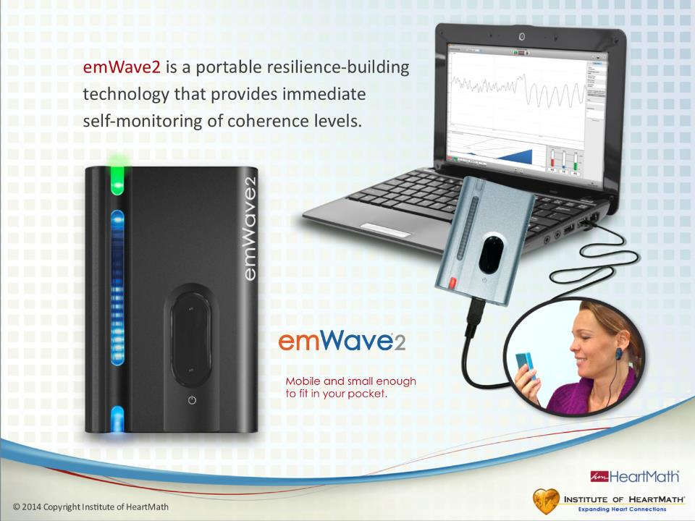
Notes:
Timing: 1 minute
Objective: Introduce the emWave2.
Key Points:
Take only the emWave2 out of the box.
The handheld unit stores your data, which can be uploaded to your computer. No one else has access to your data.

Slide 49
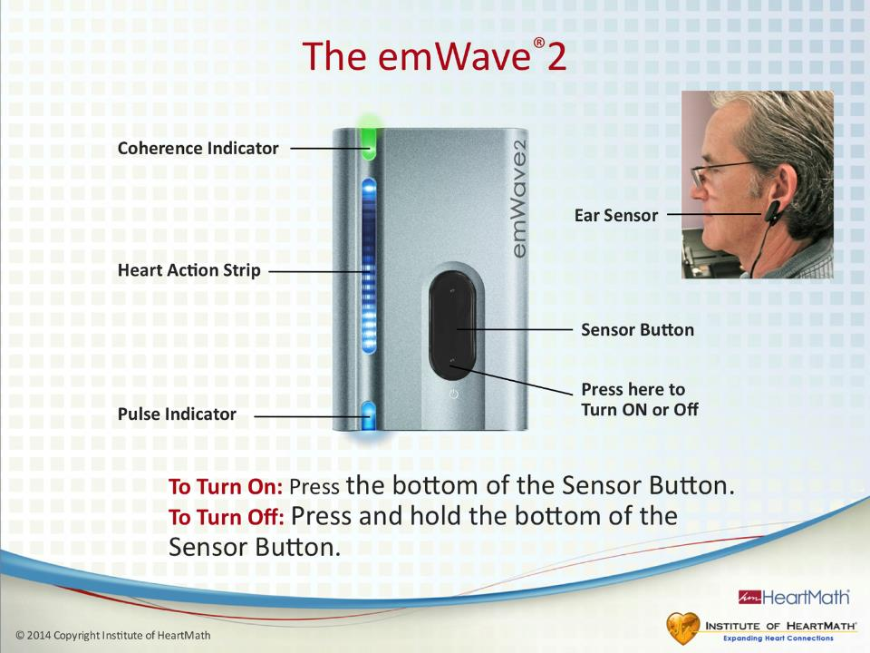
Notes:
Time: 1 minute
Objective: Explain the basics of operating the emWave2.
Key Points:
Turn it on by pressing the bottom of the sensor button.
Turn it off by pressing and holding the bottom of the sensor button.
The sensor button also can be used to pick up your pulse.
It’s easier when you are learning to use the emWave2 to use the ear sensor.
Professional golfers often put the device in their pockets and use the thumb sensor and sound feedback to make sure they are coherent before taking their shots.
Turn on the device by pressing the bottom of the button until the lights come on and then release the button.
If it turns on, press the button again to turn it off.
If it does not turn on, raise your hand for help. (If necessary, replace the unit with one that has a charged battery.)
(Note: Because of the emWave’s data storage capability, it uses some power even when turned off. If it has been stored for more than three or four weeks, it may not turn on until it is recharged. When you have small groups, check the emWave unit in advance and charge them, if necessary. This is not possible with large groups, so have some extras available. Simply recharge the ones that do not turn on. )
Next, take the ear sensor out of the box, plug it into the device and place it on your ear lobe.
Turn on the device.
There should be a blue flashing light at the bottom of the emWave that shows the device is reading your pulse.
The device will automatically turn off after about 20 seconds if a pulse is not detected.
Leave the emWave on while we go through the next few slides.

Slide 50
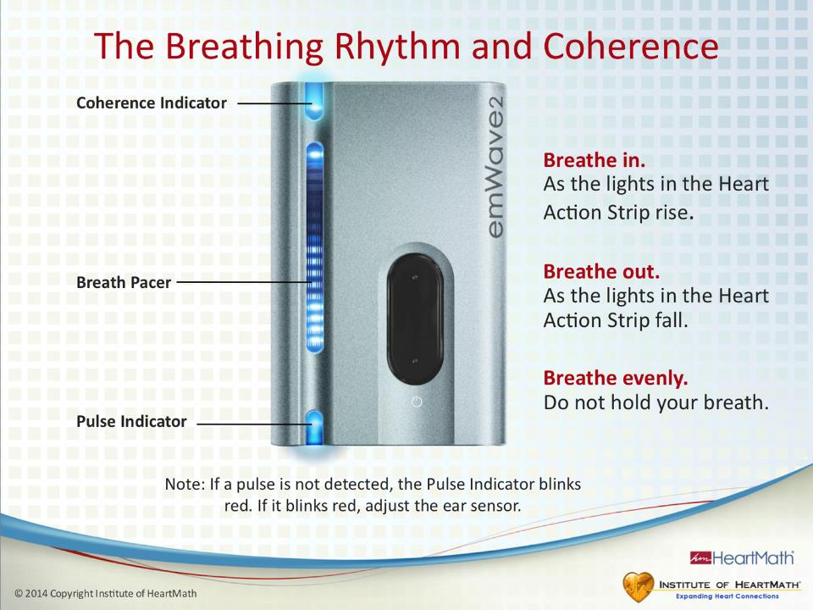
Notes:
Time: 3 minutes
Objective: Give instructions about the breath pacer and the coherence indicator.
Key Points:
After about 10 seconds the lights on the display should start moving up and down.
Breathing along with the lighted strip will help guide you into coherence.
Inhale as the lights go up.
Exhale as the lights go down.
Breathe evenly and do not force your breath or hold it. Remember to use the Heart-Focused Breathing® Technique and see if you can move into medium or high coherence. Do not get frustrated if you can’t do it immediately. It may take some practice.
The coherence indicator at the top shows if you are in low, or normal (red), medium (blue) or high (green).

Slide 51
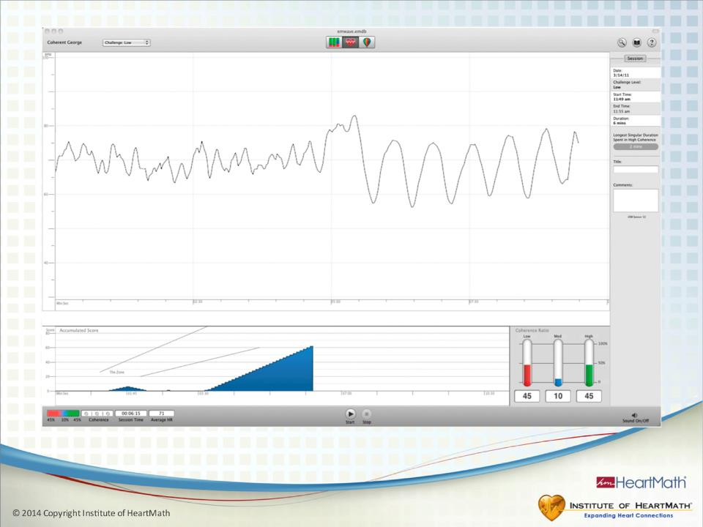
Notes:
Time: 2 minutes
Objective: Show what a session looks like in the computer software.
Key Points:
This slide shows an accumulated score at the bottom right of the screen; the percentage of time in low, medium and high coherence for the session; and heart rhythms.
The software can be installed on Macs or PCs.
You can upload your data, review sessions and play games. If you have access to the Dual Drive™ game, it will work with the emWave2, but it can be loaded only on a PC. Tropical Heat™ is another game that works with both Mac and PC.

Slide 52
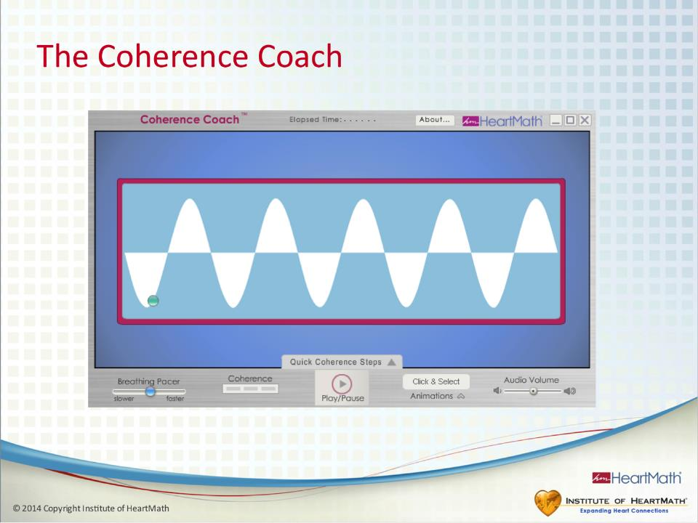
Notes:
Time: 2 minutes
Objective: Tell participants about the Coherence Coach feature contained in the software.

Slide 53
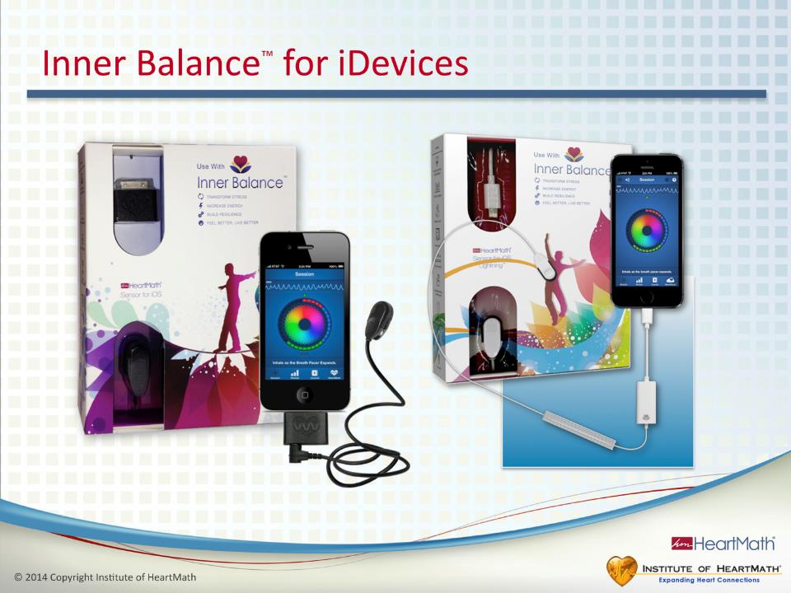
Notes:
Time: 1 minute
Objective: Inform participants about the Inner Balance app for iPhones and iPads.
Key Points:
The Inner Balance sensor attaches to your iDevice and measures your coherence level. It gives you an overall achievement score, shows your heart-rhythm patterns and provides progress reports. There also is a journal feature in the software.
(Add the technology slides that illustrate the screens and functions here if you are demonstrating this technology.)
Transition: Let’s learn three basic strategies for building and sustaining our resilience.

Slide 54
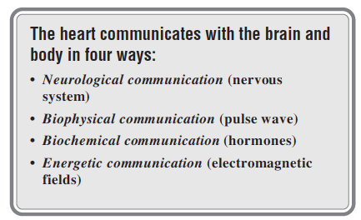

Slide 55
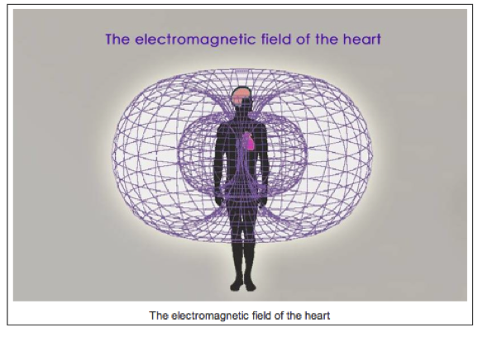

Slide 56
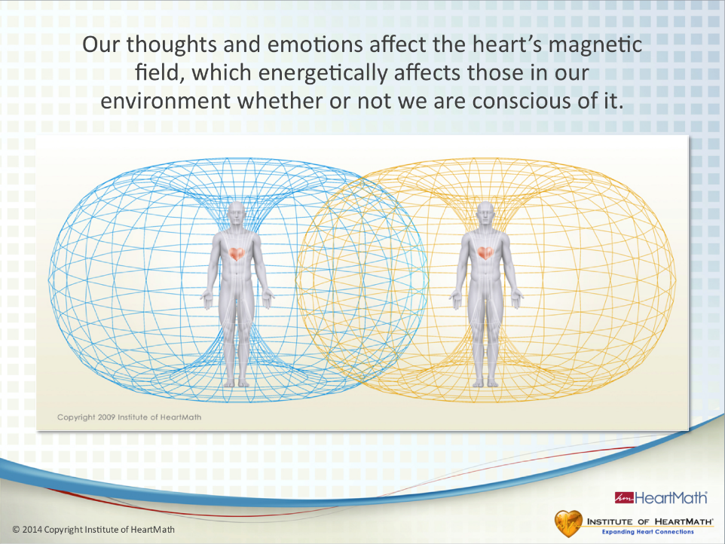
Notes:
Time: 3 minutes
Objective: Explain how the quality of our thoughts and emotions can affect the heart’s magnetic field and influence others in our environment.
Key Points:
•Ask: Have you ever walked into someone’s office and sensed that something was off and later learned that the person had just received a phone call with bad news or had been in an argument? On the other hand, have you ever noticed how it simply feels good to be around certain people? Many of us have had these kinds of experiences.
•Science now can explain how this is possible.
•Every time the heart beats, it produces electricity. Whenever electricity is produced, a magnetic field is created. That is basic physics.
•The magnetic field is unique because it can penetrate things such as skin and it travels out from the body, acting as a carrier wave of information.
•Magnetometers are used to measure the heart’s magnetic field, which can be measured up to 3 feet away from the body. This is a computer-generated model of the shape of the magnetic field.
•The brain also has a magnetic field, but it radiates only about an inch away from the head.
•The heart’s magnetic field actually travels much farther, but the distances in which the field can be detected are limited by the sensitivity of the instruments.
•The magnetic field is not the same as what some call an aura. It is a measurable field and is the same type of field used by cell phones, radios and televisions to carry information.
•You can think of the magnetic field generated by the heart as your personal field environment.
Additional Key Points:
Many hospitals use instruments called SQUIDs (superconducting quantum interface devices) that measure the magnetic fields produced by the heart and brain.
Transition: Scientists have shown that our thoughts and emotions affect the information contained in the heart’s magnetic field environment and therefore affect those around us.

Slide 57
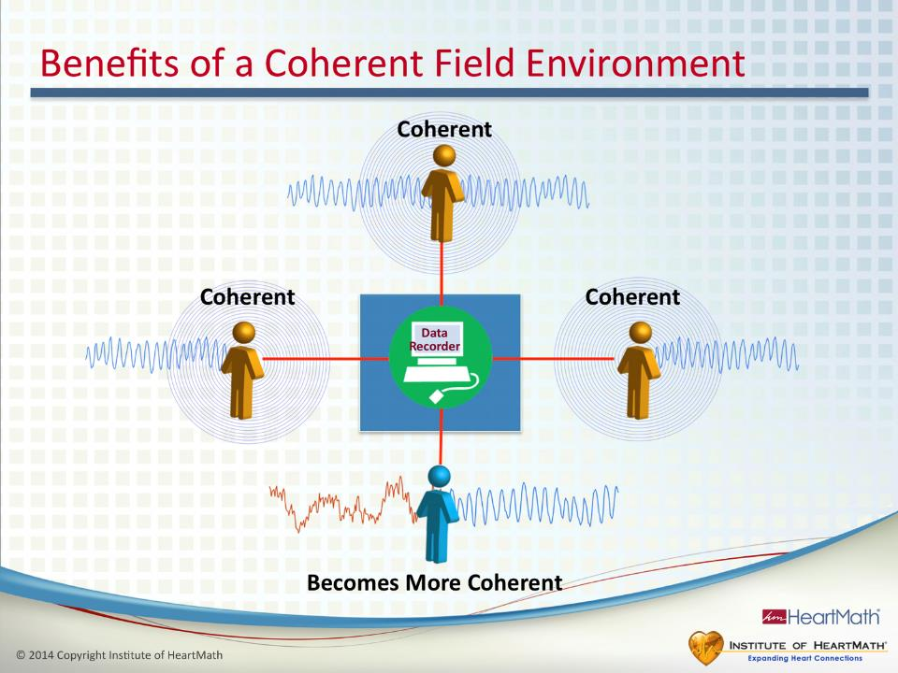
Notes:
Time: 2 minutes
Objective: Describe a study that shows how shifting into a coherent state can help others become more coherent.
Key Points:
We all are familiar with what it feels like when the emotional atmosphere at work is tense and incoherent.
Ask: Have you ever sensed the tension in the air? Do you even want to go to work when the atmosphere is like that?
In contrast, we look forward to going to work when we know there’s a feeling of excitement in the air, which can make a project we’re working on fun and rewarding.
Ask: Can you relate to that?
The following experiment helps explain the difference in those two scenarios.
In this study, participants were organized into 10 groups, with four people in each group. Each group of four people was seated around a table with each person wearing a heart-rhythm monitor to measure his or her HRV and coherence levels.
Two weeks earlier, three of the four people in each group had been taught how to shift into a coherent state.
The three people who had learned how to get coherent were instructed to shift in and out of a coherent state at specific times.
The fourth person had no knowledge of what the other three were doing.
When the three participants shifted into a coherent state, the fourth also became more coherent. Practically stated, the results of this study show that when we are in a coherent state, it can help others become more balanced and composed more quickly.
This illustrates that one of the best things we can do to support one another is maintain our personal coherence.
We create a coherent field environment that can make it easier for a person having a tough time to regain his or her balance and composure.
Ask: How can you use this knowledge to create a more coherent workplace?
Ask: How might it affect your workplace environment if the majority of you were sustaining your coherence throughout the day?
Transition: Whether or not we are aware of it, our emotional energetics has an impact on those around us.

Slide 58
SUMMARY
Display of Heart Rate Variability provides a window to your inner body to show you your stress level at that moment.
Use of slow, deep breathing and positive feeling while looking through the ‘window’ (biofeedback) can reduce your stress level and make you coherent.
When your heart produces a coherent HRV signal, all the cells in your body benefit as do all the people around you.

Slide 59

Notes:
Time: 5 minutes
Objective: Wrap up the workshop, fill out evaluations and discuss more resources that are available on the IHM website.
Key Points:
(Share closing comments.)
(Encourage them to implement their action plans right away and to practice the techniques, even when they don’t feel they need to do so.)
(Mention additional resources.)
(Optional: Ask participants to fill out evaluations.)

