Slide 1
Revision and the Review Process
Shelley Hawthorne Smith
Emily Kotay
July 2016

Slide 2
Introductions
Shelley Hawthorne Smith – Assistant Director of the Office of Fellowships and Community Engagement, UA Graduate College (shellh@email.arizona.edu)
Emily Kotay – Scholarship Advisor, Office of Nationally Competitive Scholarships in the UA Honor’s College (emkotay@email.arizona.edu)

Slide 3
Workshop Goals
Identify revision strategies
Identify top priorities for revision
Have a brief experience of the review process

Slide 4
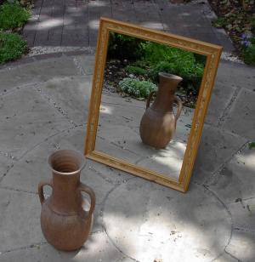
Revision Strategies
What are your strategies?

Slide 5
Some revision strategies
Wait
Have others read it
Respond to the drafts of other applicants
Read aloud

Slide 6
Global Revision
Begin with the big picture:
Do I answer the questions? Do I answer the questions behind the questions?
Do I speak to the review criteria?
Do I speak to my audience?
What is my main point? Is it specific enough?
Do I support my main point?
Is the essay cohesive? Does it flow logically?
By the end of the essay, have the ideas progressed?

Slide 7
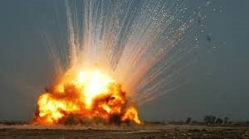
Just expect it.

Slide 8
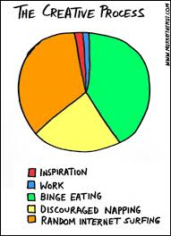
Creative Process
This is great!
This is tricky.
This is a disaster.
I am an utter failure. Maybe I’ll give up.
Maybe I can do this.
This is great!
Repeat.

Slide 9
Local Revision
Do I lead my paragraphs with a main idea?
Are my sentences varied and fairly simple?
Have I defined my key terms?
Where could I be more specific?
Are any parts confusing?
Can I use more active verbs? (cut passive verbs)

Slide 10
Specificity
Can you make these sentences more specific?
I was seven when I knew I wanted to be an anthropologist and I never wavered from that goal.
I will learn about the tooth brushing habits of several people.
Several studies have pointed to the fact that people do not brush their teeth correctly.
Find at least two of your own sentences that could be more specific and revise them.

Slide 11
Active Verbs
When possible, use active verbs rather than passive verbs:
Many of the material structures of most modern states are lacking in Oman.
Oman lacks many of the material structures of most modern states.
Throughout Latin America and the world, rural peoples are marginalized and racialized through discourses and measures emphasizing modernity and production (Manderson and Aaby 1992; Mompati and Prinsen 2000; Goebel 1998)
Revision?
Find at least three sentences in your draft that could use active verbs and revise them.

Slide 12
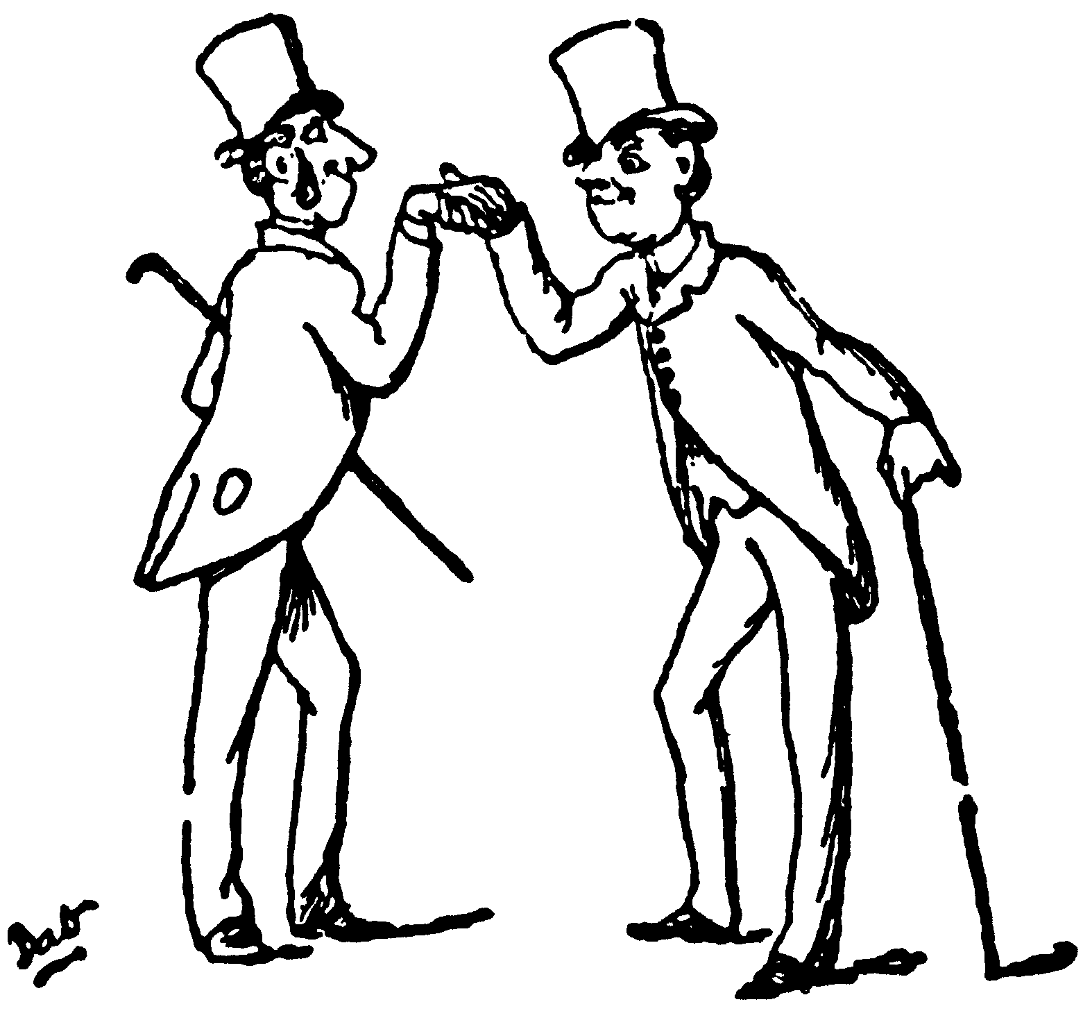
Introductions!
What do they do?
Introduce you
Introduce your topic
Present a roadmap for your essay
(Hopefully) make the reader want to read your essay
Techniques for introductions? (But use responsibly.)

Slide 13
Final thoughts on revising
Remember it is an ongoing process.
Expect disaster and then re-creation.
Take all advice with a grain of salt. You cannot predict who will review your application.
Use other applicants!
Set deadlines for one another
Create writing groups (even temporary ones)

Slide 14
The Review Process
Find out as much as you can about the process.
Remember, every interaction is an interview.
Who is your reviewer? What do they know about your field? About your institution? About your research?
They will read your application quickly.
Make it easy for them.

Slide 15
Let’s Review!
NSF GRFP or Fulbright?

Slide 16
We are here to help!
Shelley Hawthorne Smith – Assistant Director of the Office of Fellowships and Community Engagement, UA Graduate College (shellh@email.arizona.edu)
Emily Kotay – Scholarship Advisor in the Office of Nationally Competitive Scholarships, UA Honors College (emkotay@email.arizona.edu)

